Slide 1



Title IX
&
Minnesota State Board Policies and System Procedures
Team Training
Investigation Office

Slide 2
Agenda
  Discover your knowledge
  Discuss and review Title IX of the Education Amendments of 1972
  Discuss and review Minnesota State Board Policies and System Procedures
    1B.3: Sexual Violence Policy
      1B.1: Equal Opportunity and Nondiscrimination in Employment and Education
  Review team and official process
    Websites (BSU and NTC)
      Organizational structure
      Complaint process
      Investigation process
  Discuss and review your role on the team
    Deputy Title IX Coordinator
    Investigator
    Process Advisor
    Decision Maker (Policy, and Appeal)

Slide 3
Purpose of Training
The purpose of this training is to:
  Build confidence of team members
  Establish foundational knowledge regarding Title IX of the Education Amendments of 1972
  Establish foundational knowledge regarding Minnesota State Board Policy, 1B.1: Equal Opportunity and Nondiscrimination in Employment and Education
  Establish foundational knowledge regarding Minnesota State Board Policy, 1B.3: Sexual Violence Policy
  Establish foundational knowledge regarding Minnesota State System Procedure, 1B.3.1: Response to Sexual Violence and Title IX Sexual Harassment
  Provide firm expectations per team position

Slide 4
Evaluating Our Knowledge
Let’s discuss!
What do you know about Title IX?
What do you know about MN State Board Policies and Procedures related to 1B.1/1B.1.1, and 1B.3, 1B.3.1?

Slide 5
Title IX of the Education Amendments of 1972
Historical context
20 U.S.C. § 1681 & 34 C.F.R. Part 106 (1972), “No person in the United States shall, on the basis of sex, be excluded from participation in, be denied the benefits of, or be subjected to discrimination under any educational program or activity receiving federal financial assistance.”
1972 Title IX was signed into law.
Current context
2020 Title IX regulations were issued.
Covers:
  Sex-based discrimination
    Program equity, recruitment, admissions, and access, pregnancy, athletics, employment, recruitment, and hiring, extra-curricular activities, housing, access to course offerings, salaries and benefits, financial assistance, facilities, funding, sex, sexual orientation, and gender identity
Covers:
  Sexual harassment
    Quid pro quo
    Hostile environment
    Sexual assault
      Rape, Sodomy, Sexual assault with an object, Fondling, Incest, Statutory rape
  Domestic violence
  Dating violence
  Stalking
  Sexual exploitation
  Retaliation
Resource
Department of Justice
Notes:
Resource: https://www.justice.gov/crt/title-ix

Slide 6
MN State Board Policies
1B.1: Equal Opportunity and Nondiscrimination in employment and Education
Covers:
  Retaliation
  Discrimination
  Harassment
  Sexual Harassment
1B.3: Sexual Violence Policy
Covers:
  Sexual Violence
    Dating, intimate partner, and relationship violence
    Non-forcible sex acts
    Sexual assault
    Stalking
    Aiding acts of sexual violence
    Sexual exploitation (not stated in 1B.3, but could fall under here)

Slide 7
MN State System Procedures
1B.3.1: Response to Sexual Violence and Title IX Sexual Harassment
Part 7, Subpart C, 6
Part 7, Subpart D, 2
Sexual violence prevention and education, Subpart A

Slide 8
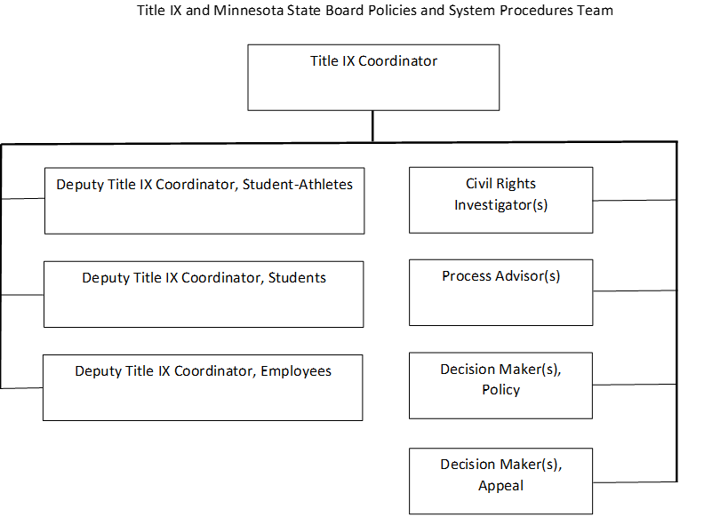
Organizational Structure

Slide 9
Complaint Process
Formal complaint vs. Informal complaint
  Everything starts with a report of some type
  No matter the complaint type the following protocol will be followed:
    Supportive measures presented
    Intake
      Investigation started or case closed
Filing a Complaint

Slide 10
Process Advisor
Key duties for your role:
  Training institutionally
  Support respondent and complainant throughout the investigation process
    Party rights
    Support measures
    Support investigation process

Slide 11
Role Play Exercise
As you prepare for your role it is essential that you feel prepared. In this exercise, we will review four scenarios and role play.
Scenario Questions to Consider:
  What would you do first?
  How will you take care of yourself through the process?
  What resources are needed for the party?
  What are your next steps in supporting the party?
  What are some concerns that you have?
  What should you report back to the Title IX Coordinator or Deputy Title IX Coordinator?

