Slide 2
Notes:
Shared vision for a stronger social care safety net!

Slide 3
Co-Creation Process, Engagement & Evaluation
Key Stakeholders/Community Partners
Vetting vendors
Language/messaging, branding
Community stewards
Community Engagement
Regional Action Teams
3 Goals – Seekers, Helpers & CBO’s
Research & Evaluation
Community Based Participatory Evaluation
Community Site Leadership
“Non-Listables”
Set & monitor targets
Site-wide decisions

Slide 4
Our Mission:
To connect all people in need and the programs that serve them (with dignity and ease).

Slide 7
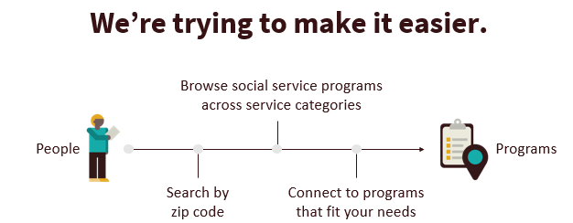

Slide 8
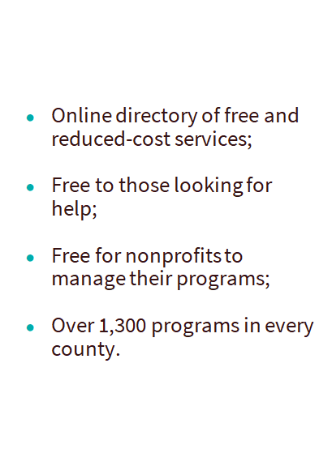
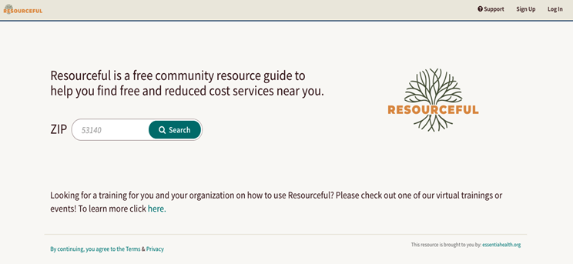
What is Resourceful?

Slide 9
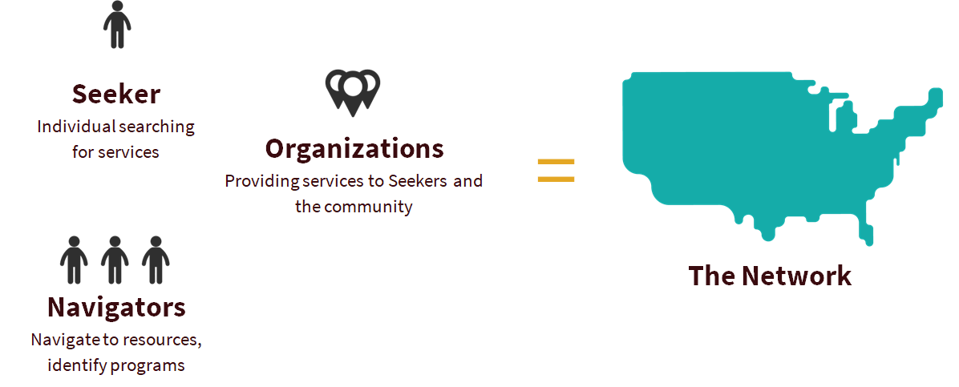
Who uses Resourceful?

Slide 10
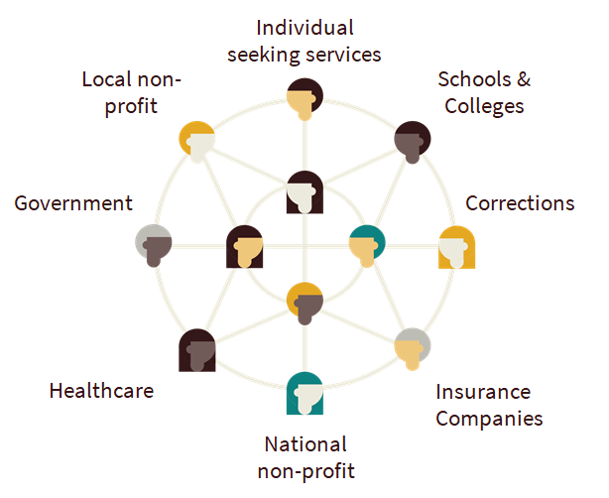
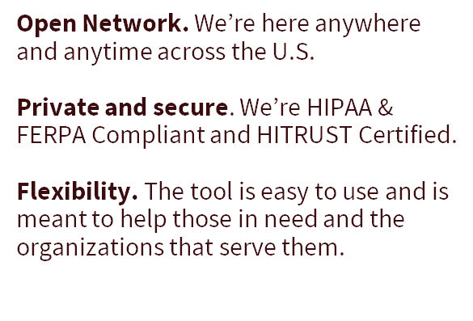
Benefits of using Resourceful on the FindHelp National Network

Slide 11
No Wrong Door to Get Help

Slide 12
How is this different than ?
2-1-1 and Resourceful are complementary; not competitive!
People in crisis will continue to call 2-1-1 for help accessing services, and CBOs will continue to refer clients to 2-1-1 as the first step in accessing services.
Many programs already listed on Resourceful show "contact 2-1-1" as their Next Step.
Key differences:
For CBOs – Ability to claim their programs/services to change listings
For providers and CBOs – Ability to make and track referrals

Slide 13
EMR Integration in Healthcare
Essentia Health is the License holder
SDoH Screening
Referrals to CHW
Resourceful – I do, We do, You do
Social Work, Emergency Dept., Cancer Center, Grief Support Services, Primary Care and Pediatrics

Slide 14
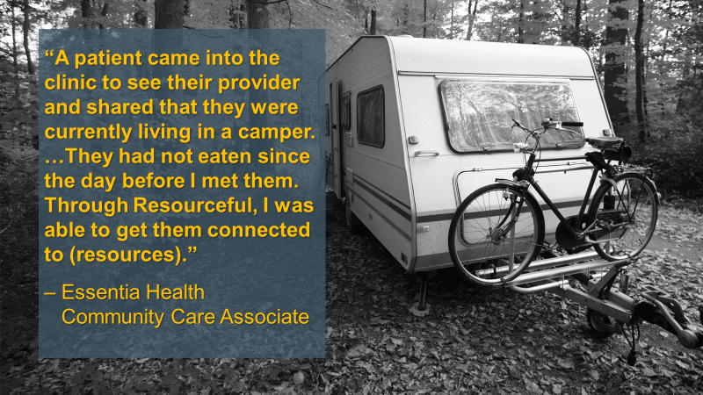
Notes:
“Recently a patient came into the clinic to see their provider and shared that they were currently living in a camper. …They had not eaten since the day before I met them. Through Resourceful, I was able to get them connected to the Damiano Center, Union Gospel Mission and Duluth Harbor Mission, which are resources able to provide them with daily meals. I also connected them to Hunger Solutions, a resource that helped connect them to other local food resources available … and helped them apply for food programs like SNAP. Then we looked at their housing and financial situation. … This camper had no running water, electricity or heat. We started with a referral to the Minnesota Department of Human Services General Assistance, which helps people without children pay for basic needs … and we sent a referral to Section 8 housing through the Housing and Redevelopment Authority to help them find and pay for housing.
Currently this person is on a waitlist for housing, and they know where they can go for help if they need a safe place to spend the night in the meantime. They do not have to wonder if they are going to be able to eat that day because of the immediate food-needs resources I connected them to. ... This person’s current living situation is not ideal, but they are in a much better place than when I met them. … I continue to check up on this individual to see how things are going, and they are using the Resourceful site on their own to find resources when they need them.”

Slide 15
Patient/Client Story – from a Community Health Worker
“Recently a patient came into the clinic to see their provider and shared that they were currently living in a camper. …They had not eaten since the day before I met them. Through Resourceful, I was able to get them connected to the Damiano Center, Union Gospel Mission and Duluth Harbor Mission, which are resources able to provide them with daily meals. I also connected them to Hunger Solutions, a resource that helped connect them to other local food resources available … and helped them apply for food programs like SNAP. Then we looked at their housing and financial situation. … This camper had no running water, electricity or heat. We started with a referral to the Minnesota Department of Human Services General Assistance, which helps people without children pay for basic needs … and we sent a referral to Section 8 housing through the Housing and Redevelopment Authority to help them find and pay for housing.
Currently this person is on a waitlist for housing, and they know where they can go for help if they need a safe place to spend the night in the meantime. They do not have to wonder if they are going to be able to eat that day because of the immediate food-needs resources I connected them to. ... This person’s current living situation is not ideal, but they are in a much better place than when I met them. … I continue to check up on this individual to see how things are going, and they are using the Resourceful site on their own to find resources when they need them.”

Slide 16
https://youtu.be/-Yd2Xvuemh0

Slide 17
Data Analytics – is it working?

Slide 18
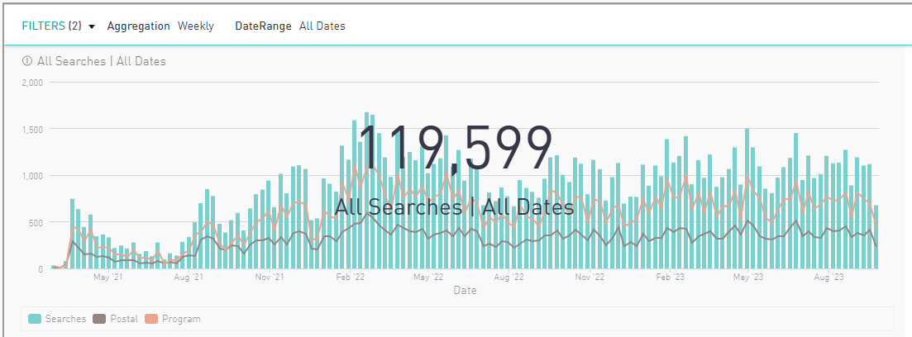
Searches: All Time

Slide 19
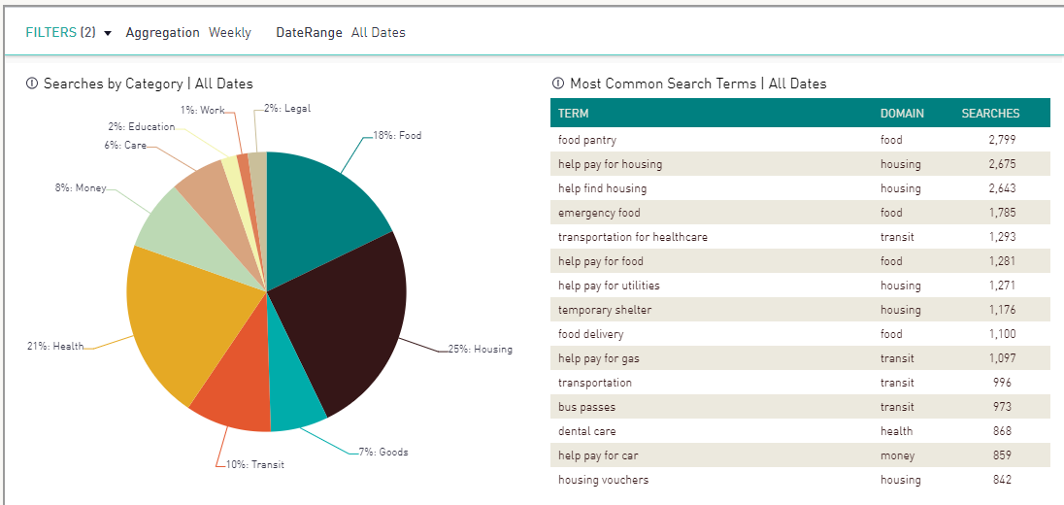
Most Common Search Terms: All Time

Slide 20
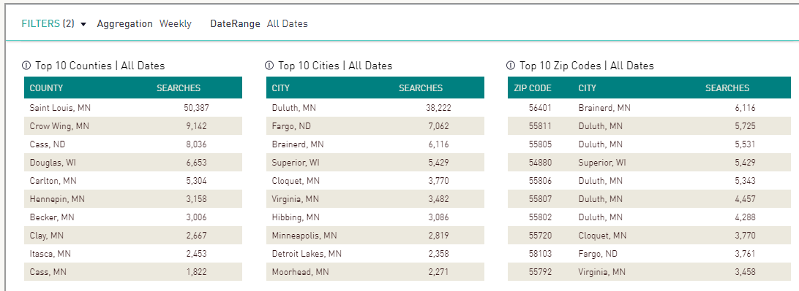
Location of Searches: All Time

Slide 21
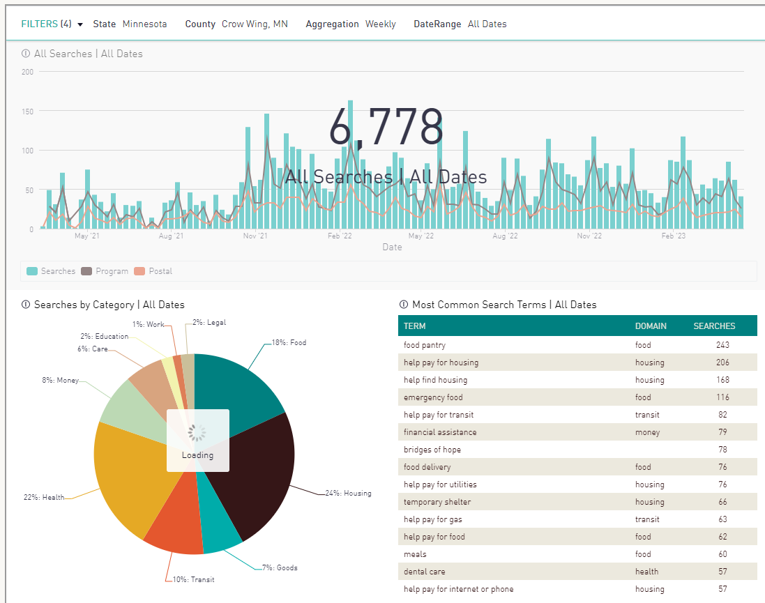
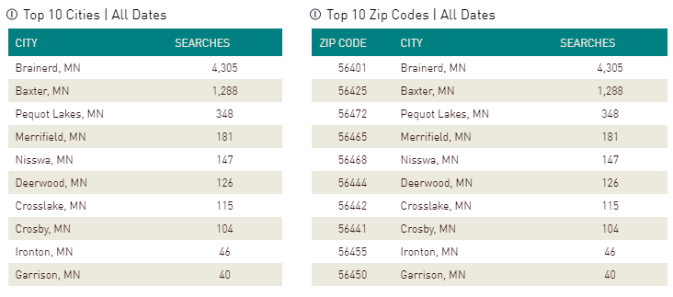
Crow Wing County

Slide 22
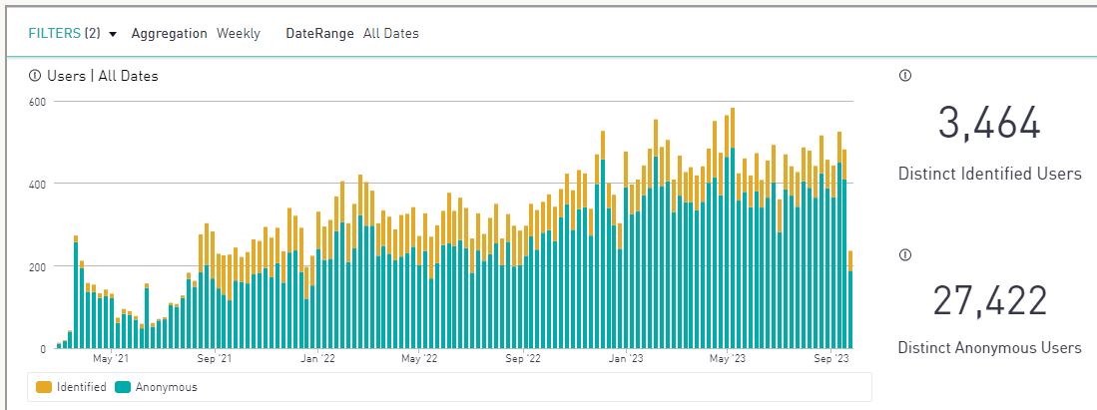
Number of Users: All Time
Notes:
Distinct Identified Users – people who have created a log-in to place referrals on behalf of someone else, access to the people I'm helping dashboard, shared favorites folders and notes with colleagues...
301 Distinct Identified Users – Crow Wing
915 Distinct Anonymous Users – Crow Wing

Slide 23
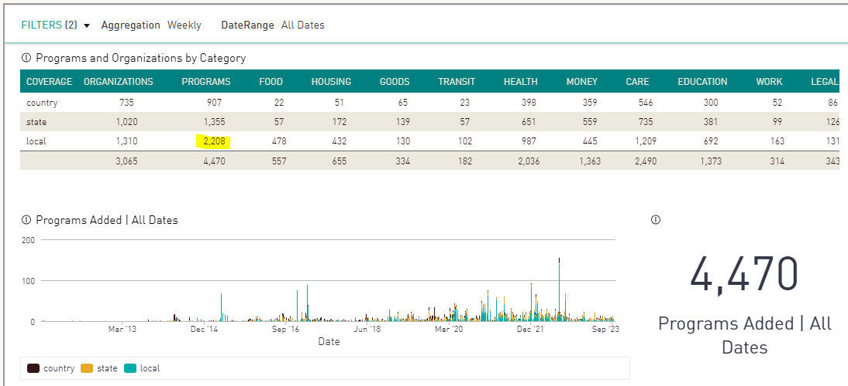
Programs Listed: All Time
Notes:
Over 4,000 local, state and federal programs listed on the platform – nearly 2,000 local!

Slide 24
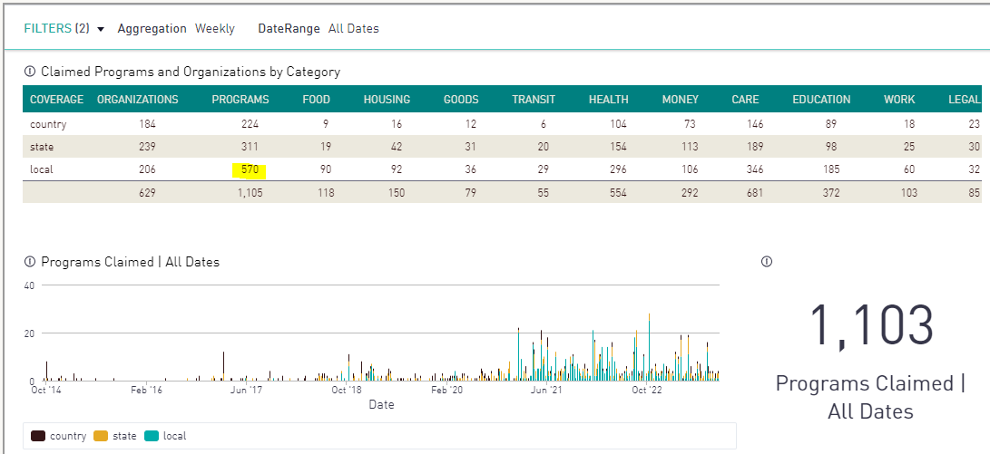
Programs Claimed: All Time

Slide 25
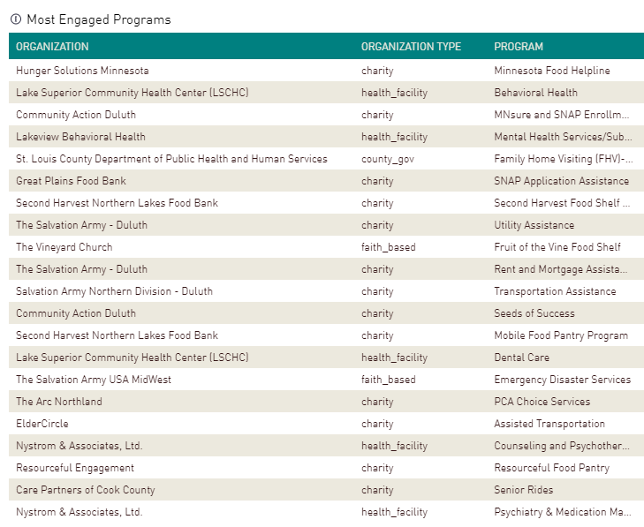
Most Engaged Programs

Slide 26
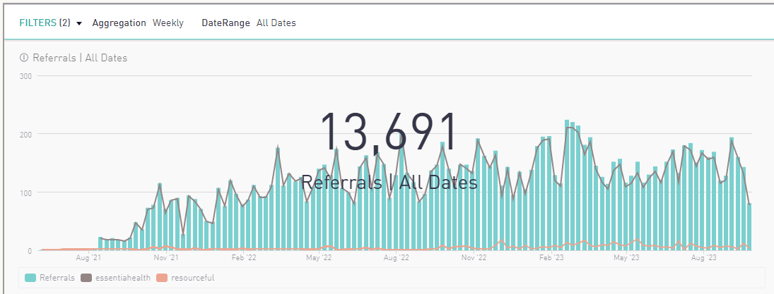
Total Referrals: All Time
Notes:
304 in Crow Wing County

Slide 27
Closed Loop: Status Updates

Slide 28
Poll:
What system of record does your team currently use to track and manage referrals?

Slide 29
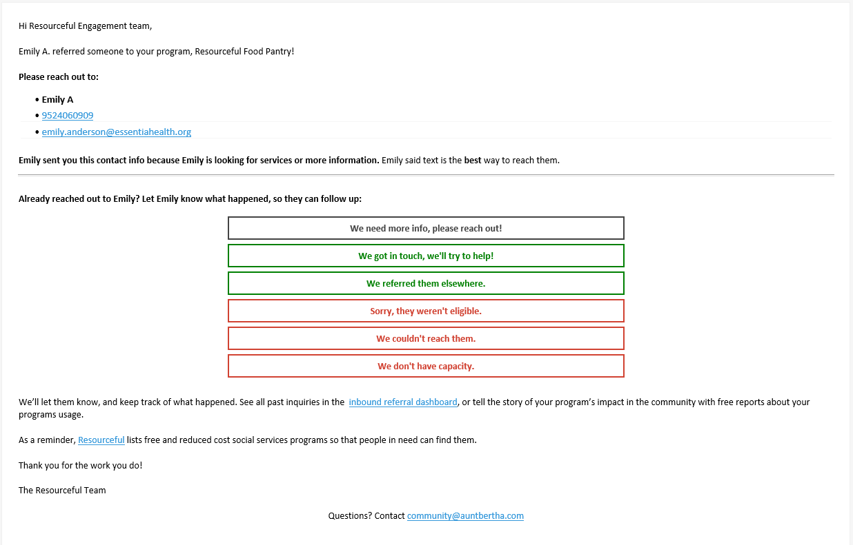
Email Referral

Slide 30
Live Demo: How it all works!

Slide 31
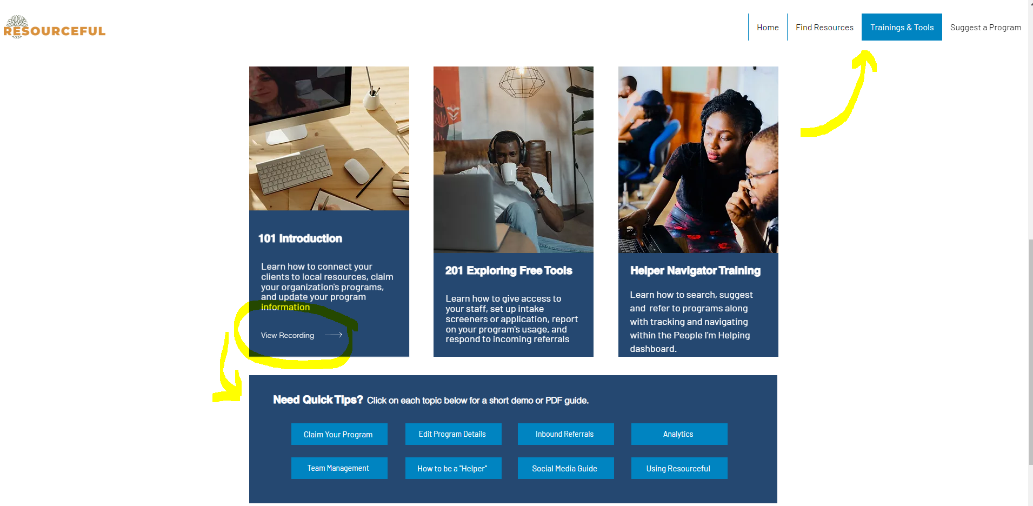
www.WeAreResourceful.org

Slide 32
I do, We do, You do!
I do:
Search by zip code
Browse by category or key word/name
Utilizing personal & program filters
Closest vs. Relevance
Anatomy of a program card
Print, save, share, notes, suggest
Referral process
Create favorites folder
Manage people you’re helping dashboard
Referral dashboard for programs
Utilize analytics for grant writing/reporting, evaluation, etc.
List & Claim your program
Edit program details
My team
We do:
Group scenario/search (we do)
You do:
Create a free account
Is your program listed? Is your program claimed? Are referrals enabled?
List your program
Claim your program
Edit your program details
Review your program analytics
Search for programs you connect with regularly
Not found – suggest a program
Found – Create/add to a favorites folder

Slide 33
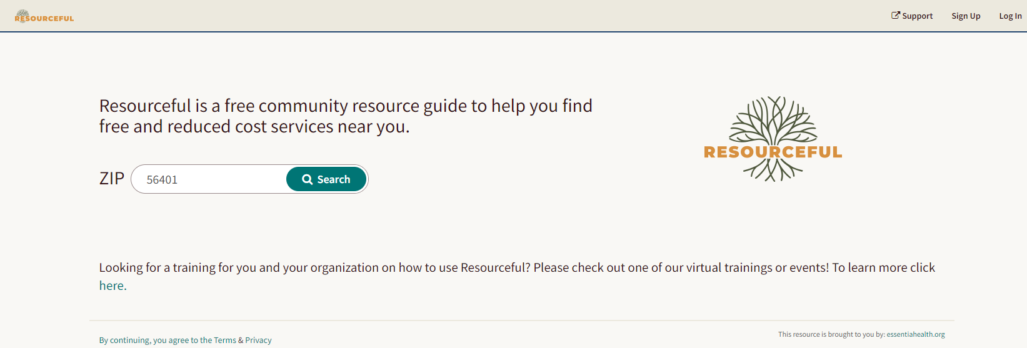
Search for programs

Slide 34
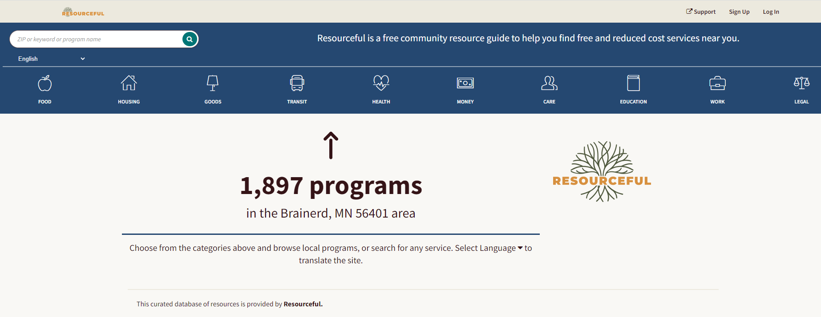
Browse social service programs

Slide 35
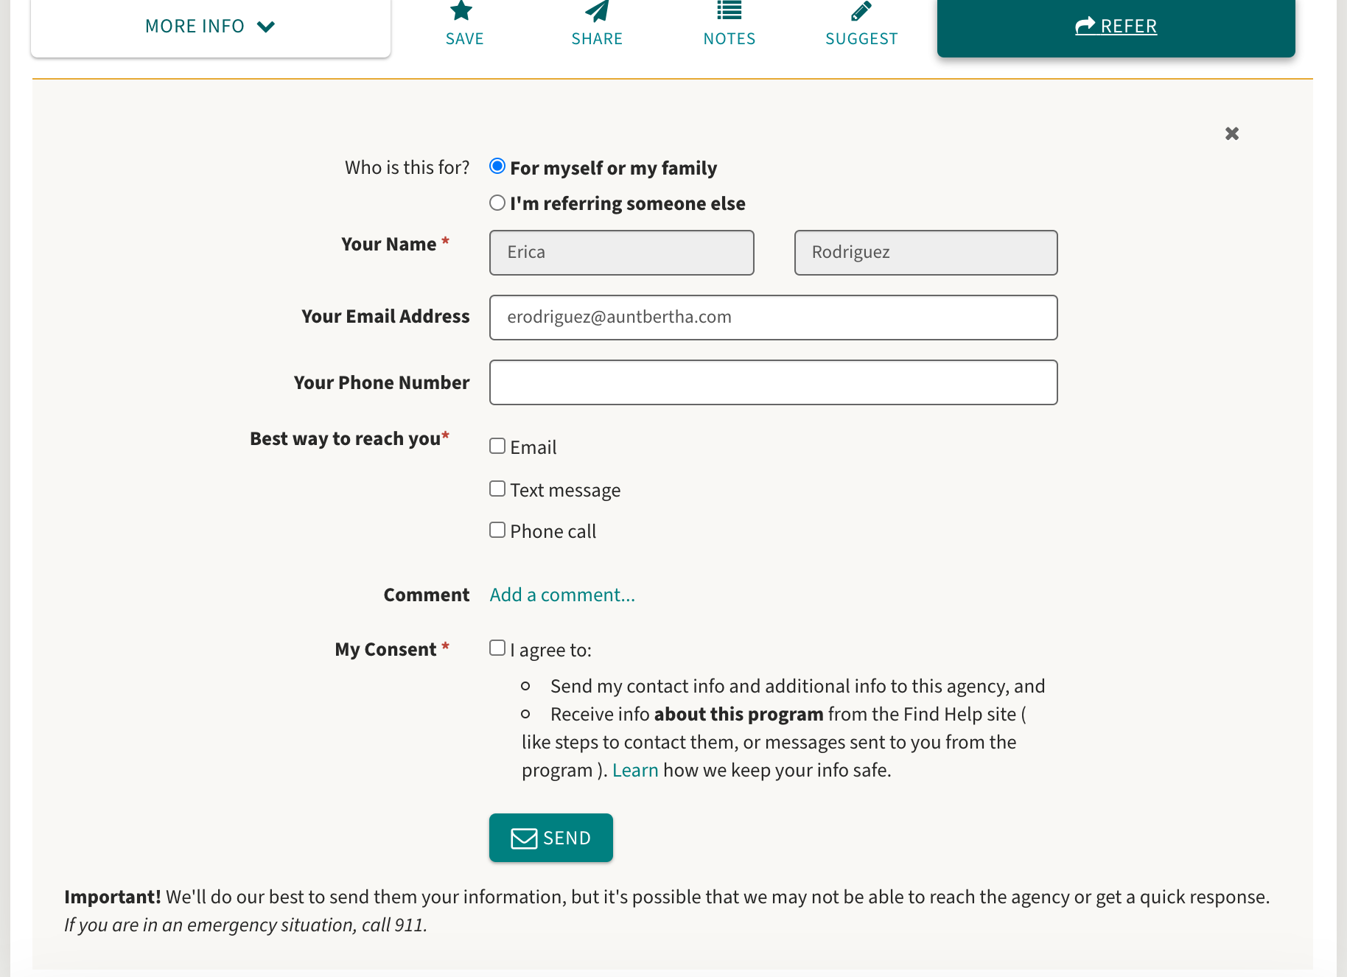
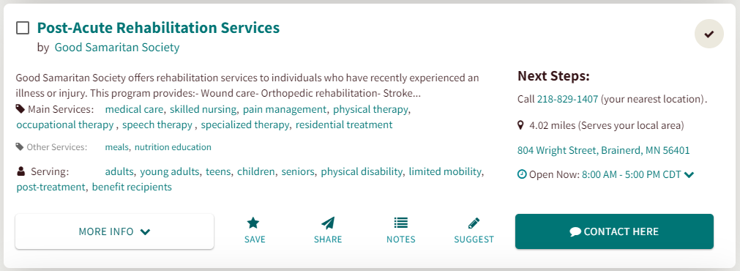
Refer to programs
Notes:
Refer people you are helping to programs through findhelp.org by clicking the teal button in the bottom right hand corner of the program card.

Slide 36
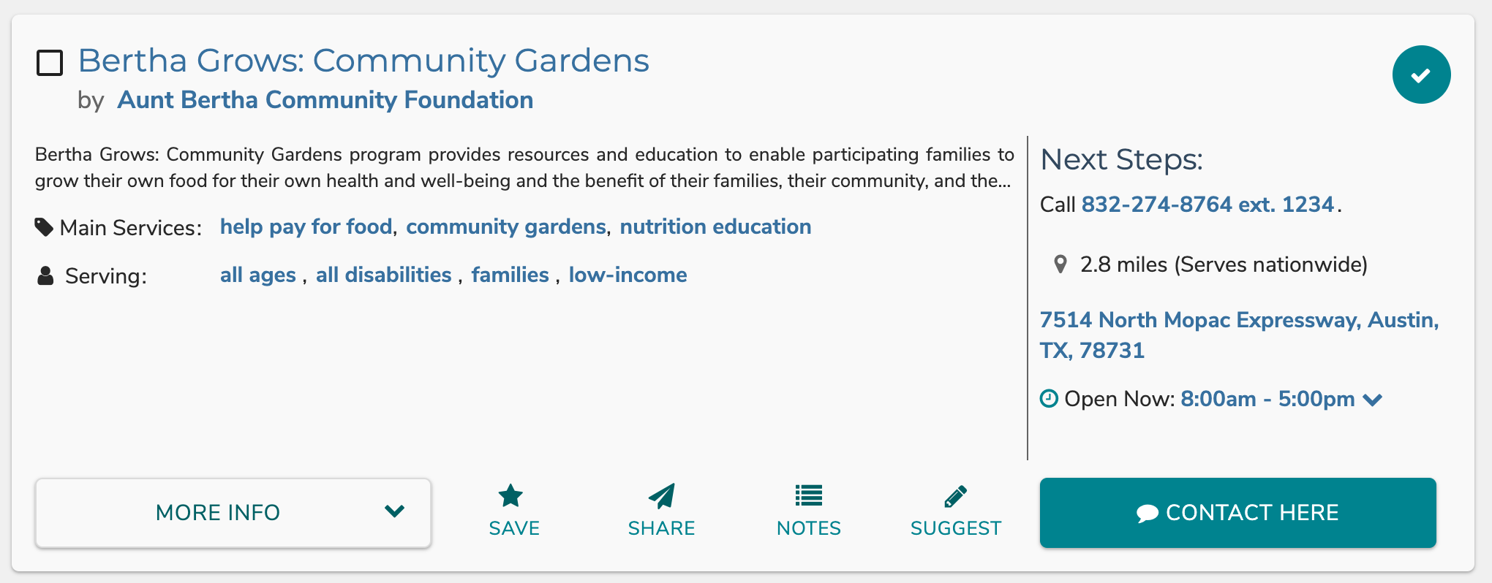
Interact with programs
Create folders of Favorite programs
Keep personal notes about programs
Notes:
Try out the search, favorites and notes sharing, and refer community members. Let us know if you have any questions or feedback - we want findhelp.org to be a useful tool for you! We invite you to “suggest a change” if you see something that is not current.

Slide 37
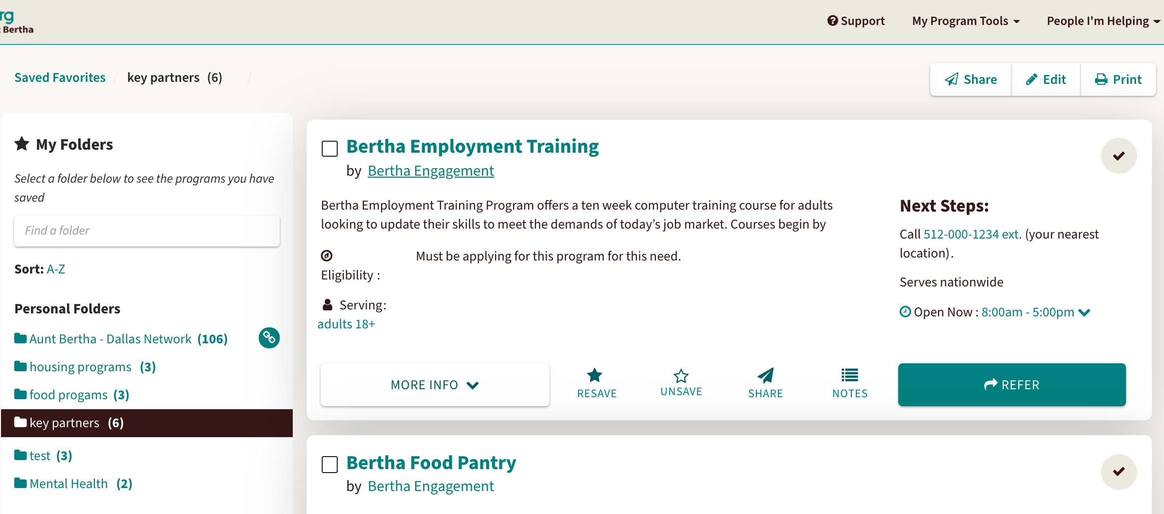
Create favorites folders

Slide 38
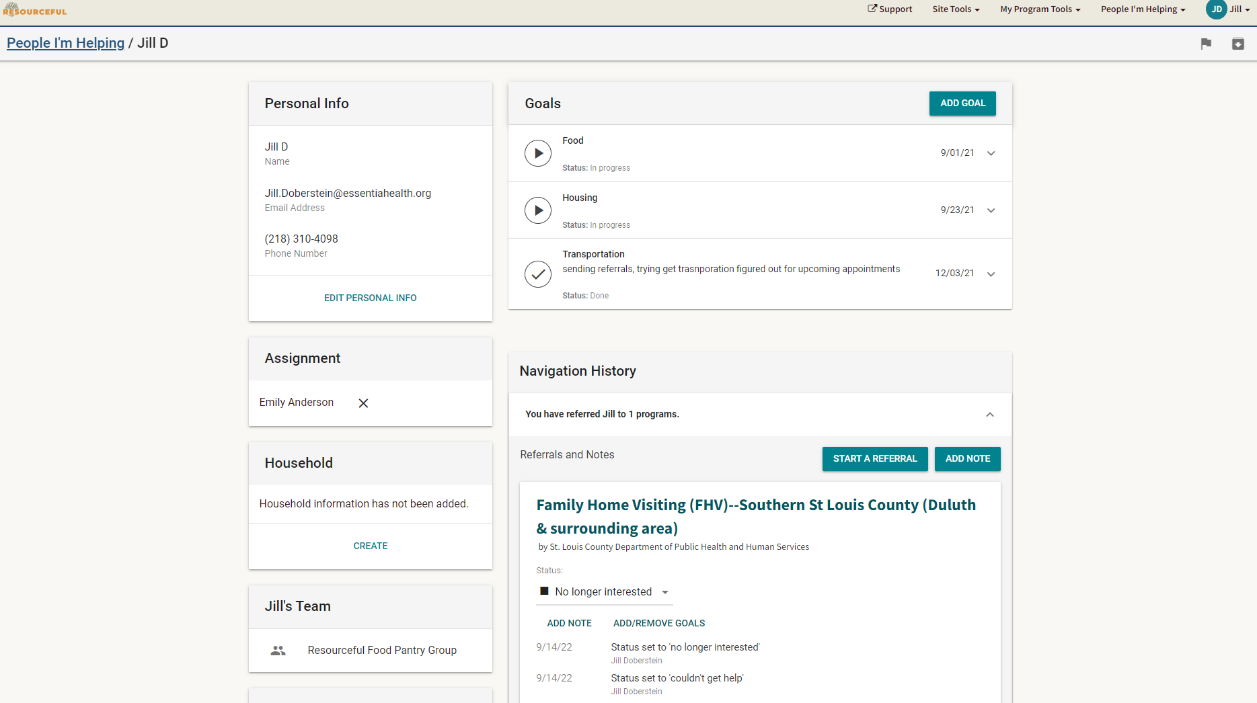
Manage people you’re helping
Notes:
Track outbound referrals and manage people you’re helping in the People I’m Helping dashboard.

Slide 39
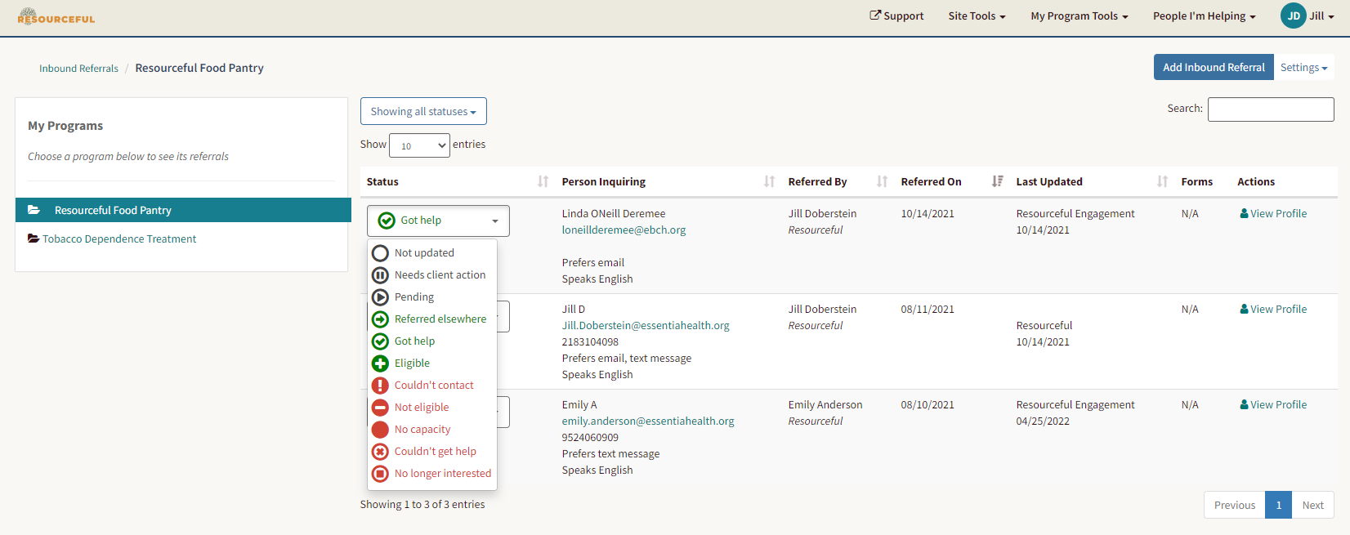
Manage your referral dashboard
Notes:
Track outbound referrals and manage people you’re helping in the People I’m Helping dashboard.

Slide 40
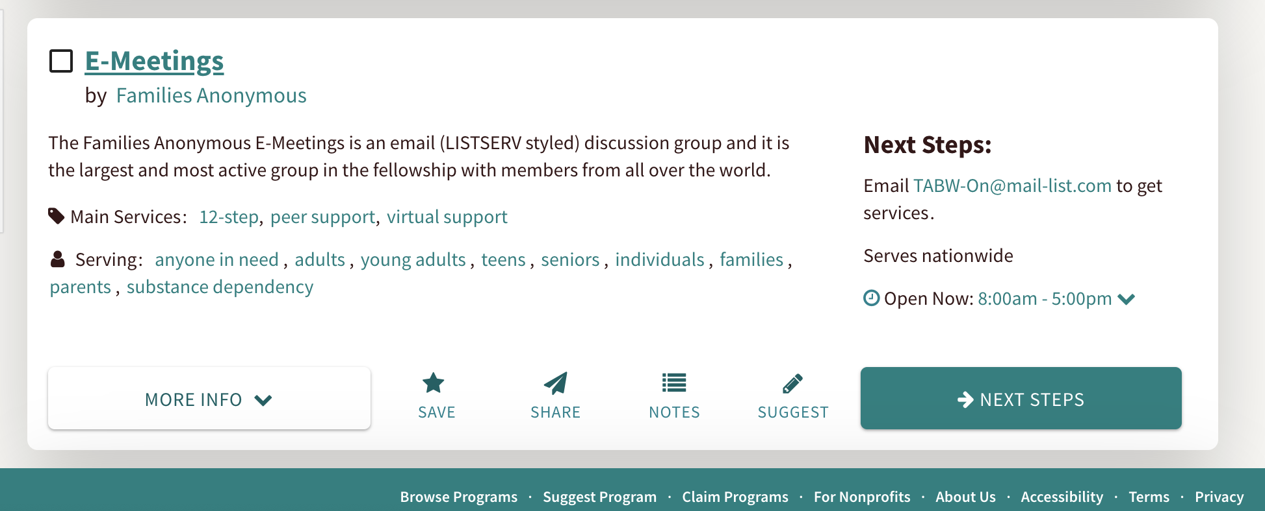
List and Claim your program(s)
Notes:
If your organization also offers services to the community, you can claim them! Its an easy and free process.
To claim, visit: findhelp.org/claims. (Add this to chat box during presentation.)

Slide 41
Pros:
Quickest and simplest tool
Get contact info to begin outreach process.
Manage from your inbox.
Considerations:
Limited information on seeker and situation.
One Step Referrals
Best For:
Programs without strict eligibility requirements or those who just need a new pipeline into an existing process.

Slide 42
Pros:
Get more information about a seeker/needs.
Quick eligibility notifications and redirections.
Considerations:
Takes more time for seeker to complete.
Screener Form
Best For:
Programs who need more information about prospective seekers to determine fit and eligibility.

Slide 43
Pros:
Time on the calendar!
Allows for longer intake conversation
Considerations:
Managing schedule = more work than other two tools.
Scheduler
Best For:
Programs who want intake managed on a calendar via intake appointments (in person or over the phone), often already have an intake meeting as part of their process.

Slide 44
Closing the Loop:
Responding to Referrals
Two Options:
Email Notification
Inbound Referral Dash

Slide 45
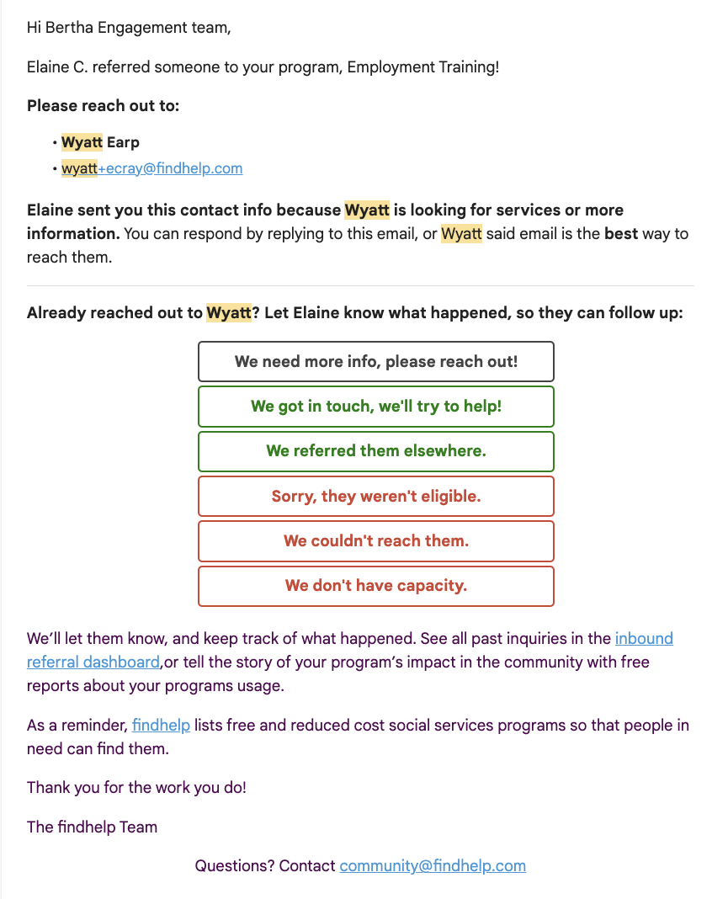
Option 1: Email Notification

Slide 46
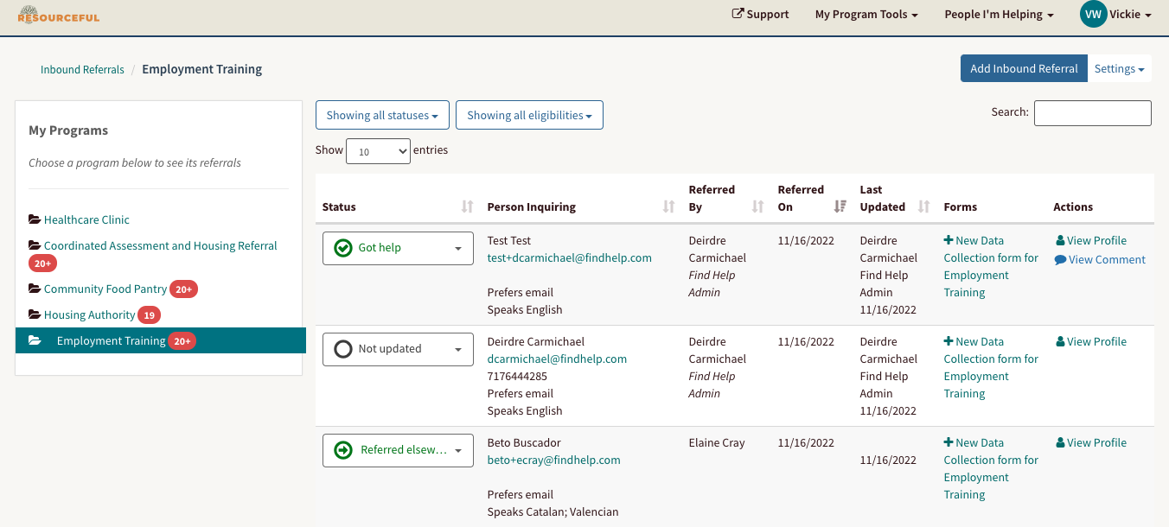
Option 2: Inbound Referral Dash

Slide 47
Organization Analytics: A Preview
Free Reporting for Claimed Programs listed on findhelp

Slide 48
Claimed Program Dashboard
Measure your impact and program engagement!
Use this Dashboard to:
Quantify all the different ways people are interacting with your programs
Show your program’s scope in program evaluations, grants and fundraising, and external reporting to funders and/or regulators
Show impact through Referral data highlights effectiveness
Demonstrate the need for additional resources or staff

Slide 49
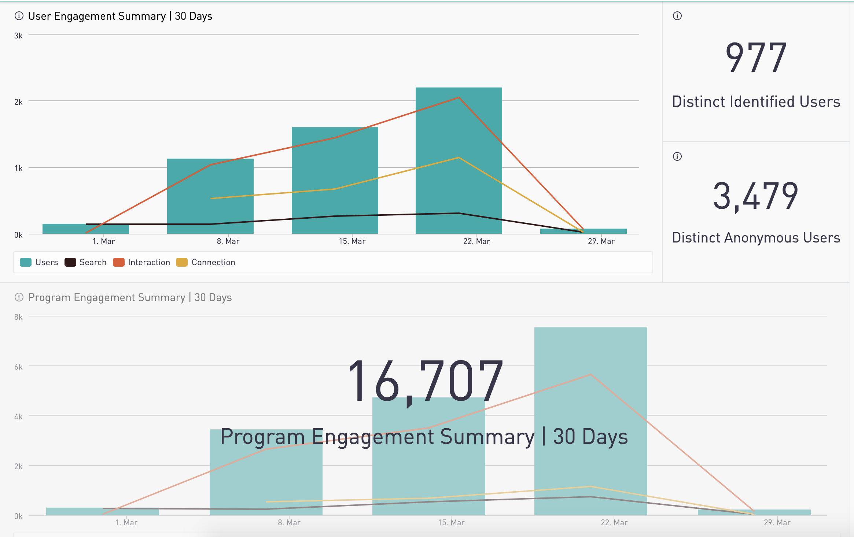
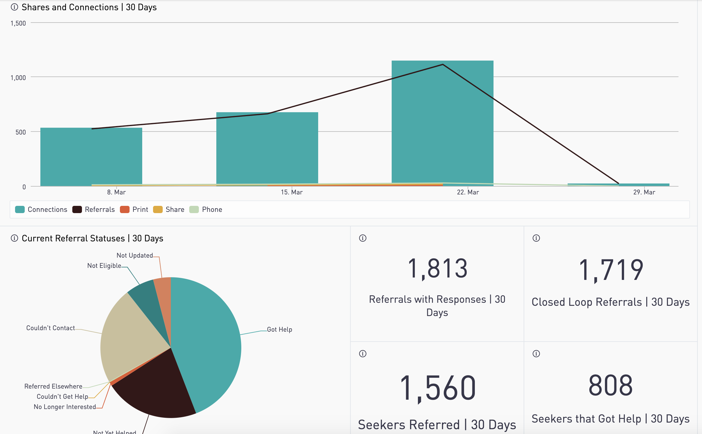
Claimed Program Dashboard

Slide 50
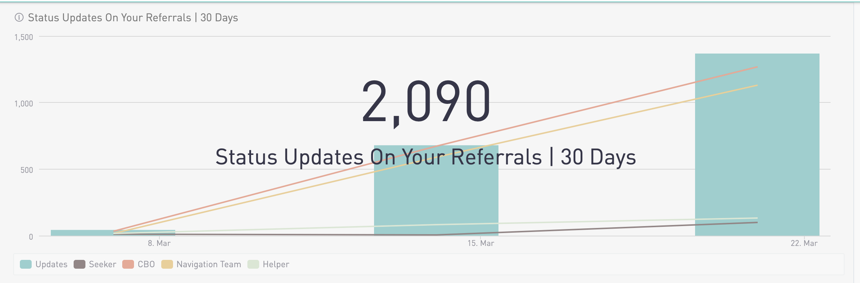
Claimed Program Dashboard

Slide 51
Search Trends in your Coverage Area
Search Trends in Your Coverage Area
Allows CBOs to view search trends in their service areas in the last 90 days
CBOs can stay informed about the needs of their communities
CBOs can use this report to demonstrate demand in their funding requests and proposals

Slide 52
Search Trends in your Coverage Area

Slide 53
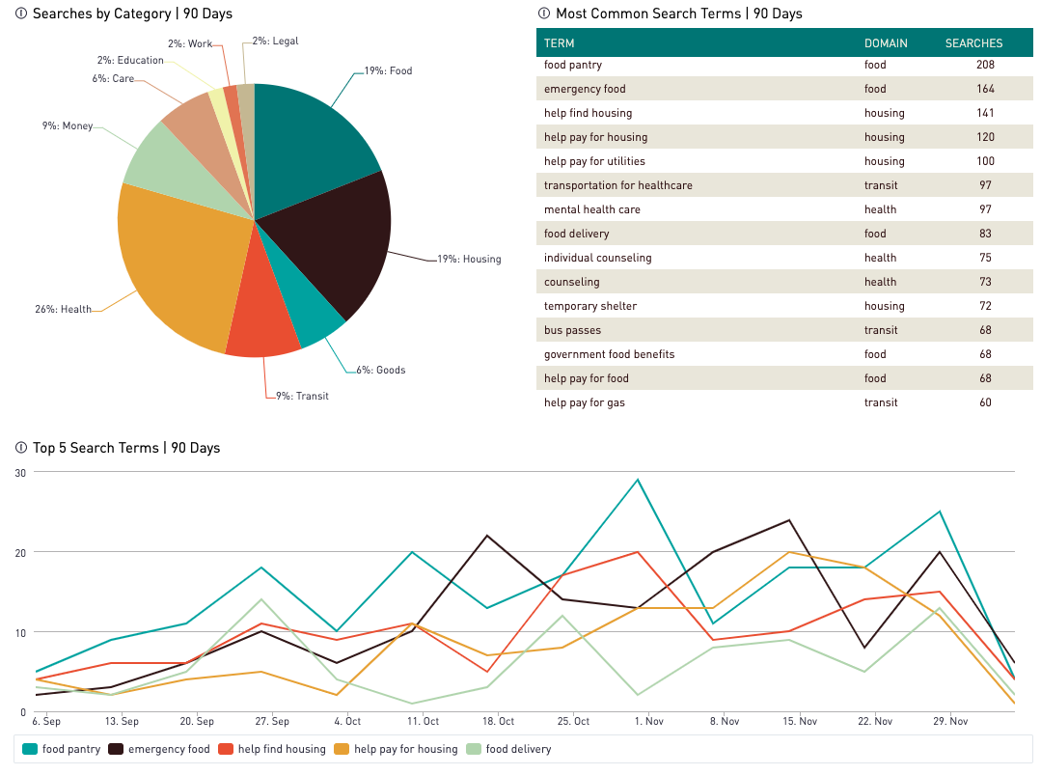
Search
Trends

Slide 54
Data
Collection
Form Report
Download your Data Collection Forms for additional analysis!
Use this Dashboard to:
Quantify the information in your Data Collection Forms;
Show your program’s impact through services rendered;
View trends of demographic data, services provided;
Understand volume of form submissions over time.
Use this Dashboard to:
Quantify the information in your Data Collection Forms;
Show your program’s impact through services rendered;
View trends of demographic data, services provided;
Understand volume of form submissions over time.
Notes:
Organizations can use these reports to quantify all the different ways people are interacting with their programs and can use this data for program evaluation, grants and fundraising, and external reporting to funders and/or regulators
Show impact - Referral data highlights effectiveness, and the need for additional resources or staff.
Demonstrate innovation - Show funders that you’re looking ahead, infusing your processes with technology to create efficiencies and to provide them with stronger insights.
Security & Privacy: PII will be in the Referral Details report. This has not changed. PII and dashboards are only visible to Claimers. Permissions to see this data are managed by the organization.

Slide 55
Data Collection Form Report
Notes:
Organizations can use these reports to quantify all the different ways people are interacting with their programs and can use this data for program evaluation, grants and fundraising, and external reporting to funders and/or regulators
Show impact - Referral data highlights effectiveness, and the need for additional resources or staff.
Demonstrate innovation - Show funders that you’re looking ahead, infusing your processes with technology to create efficiencies and to provide them with stronger insights.
Security & Privacy: PII will be in the Referral Details report. This has not changed. PII and dashboards are only visible to Claimers. Permissions to see this data are managed by the organization.

Slide 56
Let’s Connect!
Name: Jill Doberstein
Role: Essentia Community Outreach Manager
Email: Jill.Doberstein@EssentiaHealth.org
Phone: (218)786-2512
Contact Us: Resourceful@EssentiaHealth.org
Name: Vickie Walsh
Role: FindHelp Community Engagement Manager
Email: vwalsh@findhelp.com
Phone: (608)386-7657
Contact Us: support@findhelp.com
Schedule a meeting!

Slide 57
Let’s Connect!
Name: Jill Doberstein
Role: Essentia Community Outreach Manager
Email: Jill.Doberstein@EssentiaHealth.org
Phone: (218)786-2512
Contact Us: Resourceful@EssentiaHealth.org

