Slide 1
Building Your CHW Toolbox: Diabetes Prevention and Management Resources
Bridget Ideker | Diabetes Planner
Kim Matteen | Diabetes Planner
Erin McHenry Wolf | Arthritis Program Coordinator
health.state.mn.us

Slide 2
Land Acknowledgement
As we begin… we will pause and reflect.
Notes:
Kim will do the land acknowledgement

Slide 3
Land Acknowledgement
Every community owes its existence and vitality to generations from around the world who contributed their hopes, dreams, and energy to making the history that led to this moment. Some were brought here against their will, some were drawn to leave their distant homes in hope of a better life, and some have lived on this land for more generations than can be counted. Truth and acknowledgment are critical to building mutual respect and connection across all barriers of heritage and difference.
We begin this effort to acknowledge what has been buried by honoring the truth. We are standing on the ancestral lands of the Ojibwe people. We want to acknowledge the Ojibwe, Dakota, the Ho Chunk, and the other nations of people who also called this place home. We pay respects to their elders past and present. Please take a moment to consider the treaties made by the Tribal nations that entitle non-Native people to live and work on traditional Native lands. Consider the many legacies of violence, displacement, migration, and settlement that bring us together here today. Please join us in uncovering such truths at any and all public events.*
*This is the acknowledgment given in the USDAC Honor Native Land Guide – edited to reflect this space by Shannon Geshick, MTAG, Executive Director Minnesota Indian Affairs Council

Slide 4
Learning Objectives
Participants will:
Distinguish differences in Type 1 diabetes, Type 2 diabetes, gestational diabetes, and prediabetes
Identify one of the two main goals for success in preventing Type 2 diabetes through the National Diabetes Prevention Program
State one way that the Manage Your Diabetes for Life toolkit can be used with clients with diabetes
Name one evidence-based program that can be used to encourage clients to increase physical activity

Slide 5
Diabetes
DIABETES is a chronic (long-lasting) disease that affects how your body turns food into energy.
Most of the food you eat is broken down into sugar (also called glucose) and released into your bloodstream.
Your pancreas makes a hormone called insulin, which acts like a key to let the blood sugar into your body’s cells for use as energy.
Notes:
If you have diabetes, your body either doesn’t make enough insulin or can’t use the insulin it makes as well as it should. When there isn’t enough insulin or cells stop responding to insulin, too much blood sugar stays in your bloodstream, which over time can cause serious health problems, such as heart disease, vision loss and kidney disease.

Slide 6
Diabetes in Minnesota
Notes:
In 2020, 8.8% of Minnesota adults (about 390,000) had been diagnosed with diabetes (type 1 or 2).
Around 24,000 new cases are diagnosed in Minnesota each year (2018).
Around 1 in 10 people with diabetes do not know that they have the disease. 39,000 Minnesotans are walking around with diabetes and don’t know they have it. That’s the size of the city of Richfield and then some.

Slide 7
Types of Diabetes
TYPE 1 DIABETES
Type 1 diabetes is caused by an autoimmune reaction (the body attacks itself by mistake) that stops your body from making insulin.
Need to inject insulin to survive.
About 5 percent of the people who have diabetes have type 1.

Slide 8
Types of Diabetes
TYPE 2 DIABETES
With type 2 diabetes, your body doesn’t use insulin well and is unable to keep blood sugar at normal levels.
Most people with diabetes – 9 in 10 people – have type 2.
It develops over many years and is usually diagnosed in adults, though it is seen increasingly in children, teens, and young adults.

Slide 9
Types of Diabetes
GESTATIONAL DIABETES
People who are pregnant may develop gestational diabetes if their body does not produce enough insulin, leading to high blood sugar (glucose) levels.
If you have gestational diabetes, your baby could be at higher risk for health complications.
Gestational diabetes usually goes away after your baby is born but increases your risk for type 2 diabetes later in life. Your baby is more likely to develop type 2 diabetes later in life too.
Notes:
Gestational diabetes occurs during pregnancy. I’m going to use inclusive language for this definition. When people become pregnant, their body undergoes weight and hormone changes. If your body cannot produce enough insulin to adjust for these changes, your glucose levels will become too high, which is considered gestational diabetes. People with gestational diabetes have no history of type 1 or type 2 diabetes.
High blood sugar during pregnancy can result in health problems for both you and your baby.
About 8.5% of people who gave birth in Minnesota in 2020 had gestational diabetes.

Slide 10
Prediabetes
PREDIABETES
Occurs when blood sugar (glucose) levels are higher than normal, but not high enough to be diabetes
People are more likely to develop type 2 diabetes, heart disease and stroke
1 in 3 adults have prediabetes
Most people don’t know they have it
10
Notes:
Prediabetes occurs when blood sugars are higher than normal, but not high enough to be diabetes. This puts people at risk for other diseases like Type 2 diabetes, heart disease and stroke. It’s common. Nearly 1 in 3 adults in Minnesota have prediabetes. Most of them don’t know that they have it.

Slide 11
CHWs and the National Diabetes Prevention Program
Kim Matteen | Diabetes Program Planner
Kim.Matteen@state.mn.us 651-201-5434

Slide 12
www.DoIHavePrediabetes.org
What's your risk for developing Type 2 diabetes?
Take
the
Test
Notes:
How old are you. Are you a man or a woman. If you are a woman, have you ever been diagnosed with gestational diabetes. High blood pressure? Are you physically active? What’s your weight status. It’s that simple. It literally takes a minute to do, but can have lifelong impacts if you’re able to avoid developing diabetes. Please, take the test with your patients, your family members and friends. Remember, about 1 in three of us is at risk.

Slide 13
Type 2 Diabetes Is Preventable!
Teach an Evidence-Based Lifestyle Change Program
Where participants learn how to ​
eat healthy​
add physical activity to your routine​
manage stress​
stay motivated ​
solve problems ​

Slide 14
National Diabetes Prevention Program
This program is proven to prevent or delay type 2 diabetes.
Participants who lost 5-7% of their body weight and added 150 minutes of exercise per week cut their risk of developing type 2 diabetes by up to 58% (71% for people over age 60).

Slide 15
National DPP Math
Over the course of the year-long program --
lose weight and incorporate physical activity
into your routine
Weight is 160 pounds
5 % weight loss = 8 pounds
7% weight loss = 11 pounds
Weight is 200 pounds
5% weight loss = 10 pounds
7% weight loss = 14 pounds
Physical Activity
5 days a week for 30 minutes
7 days a week for 21.5 minutes

Slide 16
Sample Topics Covered Include...
Get Active to Prevent T2
Track Your Activity
Eat Well to Prevent T2
Shop and Cook to Prevent T2
Manage Stress
Take Charge of Your Thoughts
Eat Well Away from Home

Slide 17
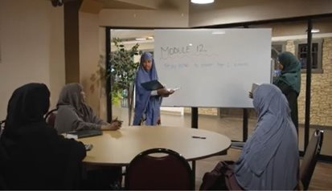
CHW's role
CHWs can ...
Refer patients to classes
Talk to patients about lifestyle change
Lead National DPP cohorts
Did you know...
CHW services can be reimbursed through MN Medicaid under group education codes for the National DPP

Slide 18
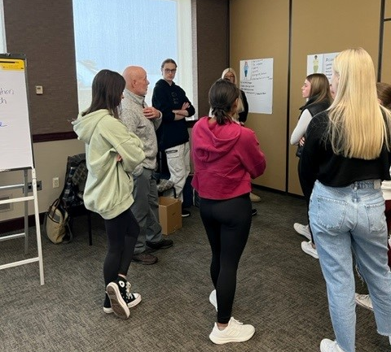
Lifestyle Coach Training
Become a trained Lifestyle Coach for the National DPP
16-hour investment
On-line or in-person
Typical cost is $650
Scholarships available on a very limited basis

Slide 19
We Want to Work with YOU
Contact Kim Matteen Kim.Matteen@state.mn.us 651-201-5434
Work to become part of the CDC's Diabetes Prevention Recognition Program
Consider your organization's capacity to provide the National DPP
Free tools, technical assistance and support are available to YOU and your organization

Slide 20
Diabetes Tools for CHWs
Bridget Ideker, RD, LD, CHWC | Diabetes Program Planner
Bridget.Ideker@state.mn.us 651-201-4718

Slide 21
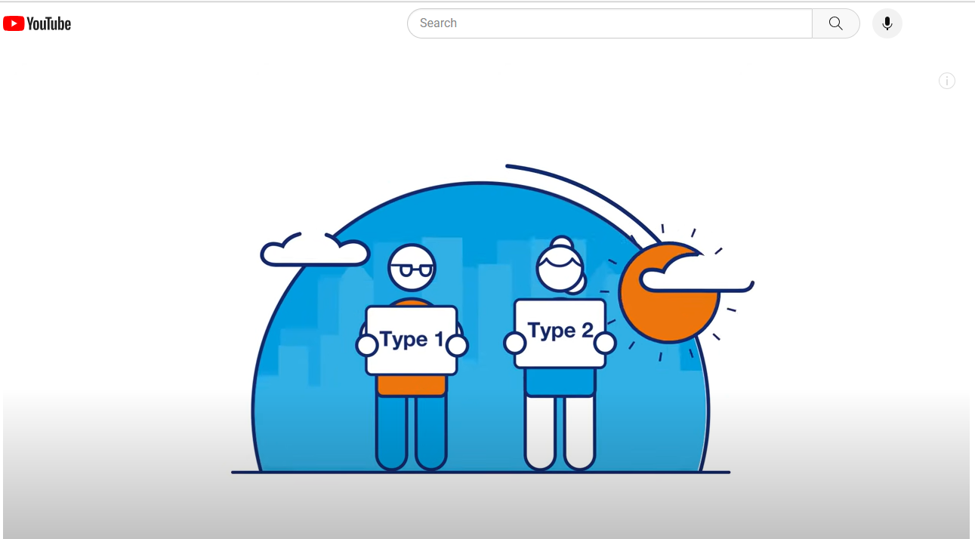
What is the difference in Type 1 and Type 2 Diabetes?
https://youtu.be/wZAjVQWbMlE

Slide 22
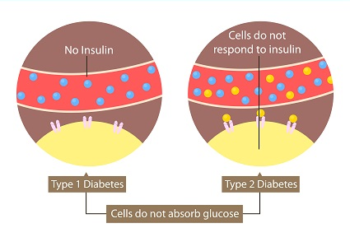
Types of Diabetes

Slide 23
Meet Mildred
53-year-old African American Female
BMI is 30.7 = ‘obese’ category
Doesn’t do regular activity
Went to the doctor complaining of increased thirst, frequently going to the bathroom and extreme fatigue
Strong family history of Type 2 Diabetes in parents and grandparents

Slide 24
Mildred
53-year-old African American Female –
Percentage of persons with diabetes by race/ethnicity In Minnesota
American Indian (19.3%)
Black, African and African American (13.4%)
Hispanic or Latino populations (11.5%)
Overall MN population 7.7%
2018-2020

Slide 25
Mildred
BMI is 30.7 = ‘obese’ category
Doesn’t do regular physical activity
Strong family history of Type 2 Diabetes in parents and grandparents
Pre-diabetes Risk Factors

Slide 26
Mildred
Went to the doctor complaining of increased thirst, frequently going to the bathroom and extreme fatigue

Slide 27
Know the Symptoms of Diabetes
Type 2 diabetes often has no symptoms, or the symptoms might go unnoticed. That is one reason why one in four people with diabetes don’t even know they have it.
Urinating often
Feeling very thirsty
Feeling very hungry even though you are eating
Extreme fatigue, especially after eating
Blurry vision
Cuts/bruises that are slow to heal
Notify your patient’s primary care provider or care team if the patient complains about these symptoms or if you notice any change in symptoms.

Slide 28
Manage Your Diabetes for Life Toolkit

Slide 29
Manage Your Diabetes for Life Toolkit
This is a patient education toolkit for health educators – designed to help adults with pre-existing diabetes manage and enjoy life. MDH recommends that patients first attend a Diabetes Self-Management and Education Support (DSMES) Program and use of this Toolkit for reinforcement of concepts.
TOOLKIT USES:
REMIND the patient of what he/she needs to do to manage their diabetes.
REINFORCE healthy behaviors.
ENCOURAGE problem-solving, goal setting and continuous learning.
INFORM people about what they should do to manage their diabetes and why these things are important.
SUPPORT small steps to maintain and improve his/her health.
Notes:
MDH recommends DSMES at the following key times: 1. at diagnosis 2. change in treatment 3. change in life such as marriage or job change and 4. annually.
The Toolkit is recommended for use with patients after the patient has received DSMES.

Slide 30
MDH Diabetes Home Page
www.health.state.mn.us/diseases/diabetes

Slide 31
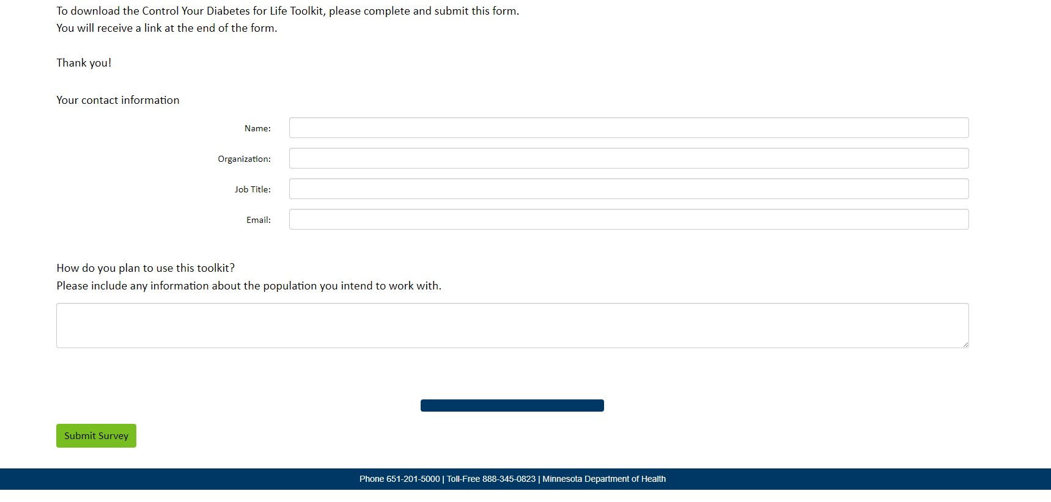
Download the Manage Your Diabetes for Life Educator Toolkit.

Slide 32
Mildred was recently diagnosed with Type 2 Diabetes
Mildred is feeling overwhelmed, stressed and frankly, a little mad about new diagnosis.
Mildred went to a DSMES program and has had several meetings with the diabetes care plan team.
Mildred states she has three main questions:
I gave up bread and I really miss it. What can I do to include it back into my diet?
I am not sure how my cholesterol affects my diabetes?
How I am supposed to add exercise into my current lifestyle?

Slide 33
Manage Your Diabetes for Life Toolkit Page 21

Slide 35
Mildred was recently diagnosed with Type 2 Diabetes
Mildred is feeling overwhelmed, stressed and frankly, a little mad about new diagnosis.
Mildred went to a DSMES program and has had several meetings with the diabetes care plan team.
Mildred states she has three main questions:
I gave up bread and I really miss it. What can I do to include it back into my diet?
I am not sure how my cholesterol affects my diabetes?
How I am supposed to add exercise into my current lifestyle?

Slide 36
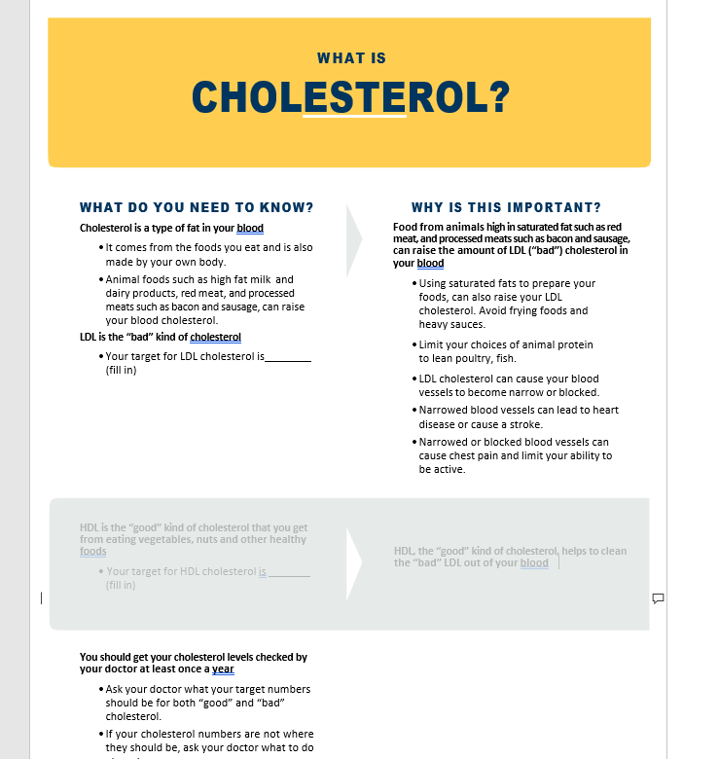
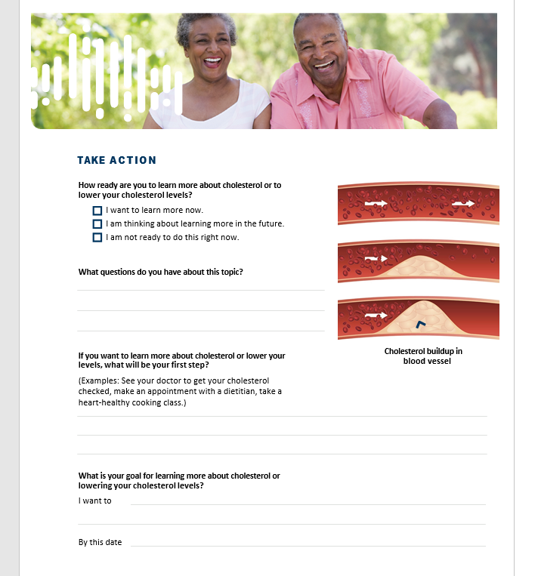
Manage Your Diabetes for Life Toolkit Page 25

Slide 37
Mildred was recently diagnosed with Type 2 Diabetes
Mildred is feeling overwhelmed, stressed and frankly, a little mad about new diagnosis.
Mildred went to a DSMES program and has had several meetings with the diabetes care plan team.
Mildred states she has three main questions:
I gave up bread and I really miss it. What can I do to include it back into my diet?
I am not sure how my cholesterol affects my diabetes?
How I am supposed to add exercise into my current lifestyle?

Slide 38
Manage Your Diabetes for Life Toolkit Page 33

Slide 39
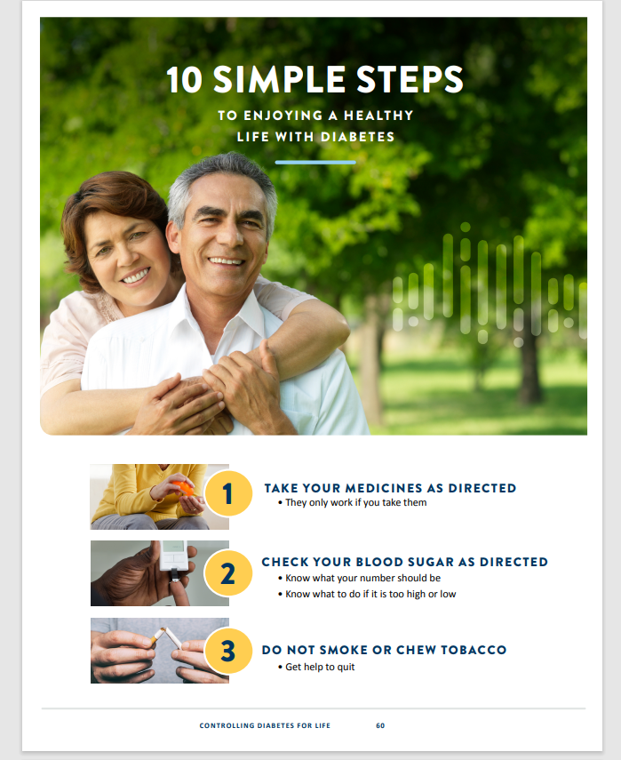
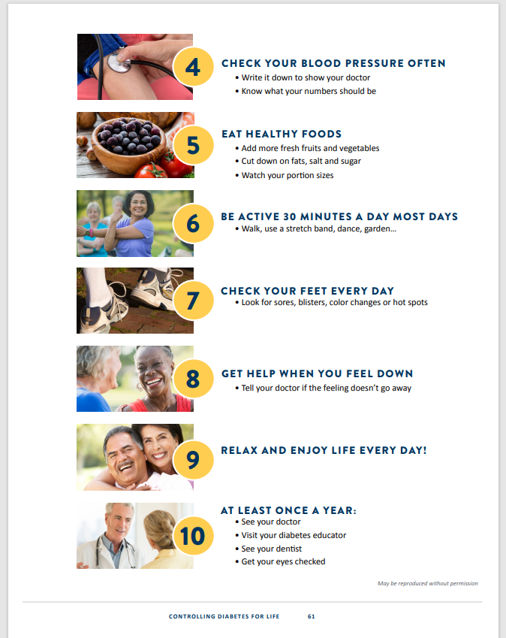
10 Simple Steps to Manage Your Blood Sugars

Slide 40
10 Simple Steps Translated
Spanish
Karen
Chuukese
Hmong
Somali

Slide 41
CHWs Role in Diabetes Management
Support Clinics’ DSMES Programs (Diabetes Self-Management and Education Support)
Lead lifestyle programs
Prepare patients for upcoming appointments/ labs needed
Integrate recommendations into culturally appropriate terms
Advocate for patients with diabetes
Key connection between patients and the diabetes care team

Slide 42
Helping Patients Get Active
Erin McHenry Wolf
erin.mchenry.wolf@state.mn.us, 651-201-3235

Slide 43
Physical activity and chronic disease
Exercise can help…
Manage arthritis pain, keep a healthy weight, strengthen bones, reduce falls risk, boost mood, manage blood pressure, support brain health, manage blood sugar, relieve stress, combat depression symptoms, increase energy and more

Slide 44
Physical activity programs
Increase strength, stamina, balance, mobility
Lose weight, manage health conditions
Build confidence and understanding
Can provide group socialization
Some can be offered online/virtually
Physical activity can help patients w/ prediabetes and diabetes lose weight, manage blood sugar, and reduce A1C

Slide 45
Types of programs
Falls prevention
Tai Ji Quan: Moving for Better Balance
Stay Active and Independent for Life (SAIL)
Tai Chi for Arthritis
Exercise
Walk With Ease
Arthritis Foundation Exercise Program
Arthritis Foundation Aquatic Program
Enhance Fitness
Fit & Strong!
Active Living Every Day
These programs pair well with health education!

Slide 46
The CHW’s role
CHWs can….
Refer patients to classes
Lead classes*
Talk to patients about physical activity
* There may be potential for CHWs to bill health promotion classes as group health education

Slide 47
Program Highlight: Walk With Ease

Slide 48
Walk With Ease
6-week evidence-based walking program
Self-directed or in a group
Gradually increase walking pace
Designed for people with joint pain or arthritis

Slide 49
Proven results
Studies at the University of North Carolina show Walk With Ease is proven to…
Reduce pain and discomfort of arthritis
Increase balance, strength and walking pace
Build confidence in ability to be active
Improve overall health

Slide 50
How can CHWs offer Walk With Ease?
Complete online, on-demand training (3-4 hrs, $89)
Must be CPR-certified
We recommend walking groups of 10-15
Group walks 3 times per week for 6 weeks
To remain a certified Walk With Ease leader, offer minimum of 1 class per year
Books cost about $11.95

Slide 51
How can CHWs refer to Walk With Ease?
Online Walk With Ease portal
Includes video modules and regular communication from Osteoarthritis Action Alliance with motivating messages and health information
Patients walk independently on their own time
CHW can check in with patients to monitor progress
Startwalkwithease.org/Minnesota

Slide 52
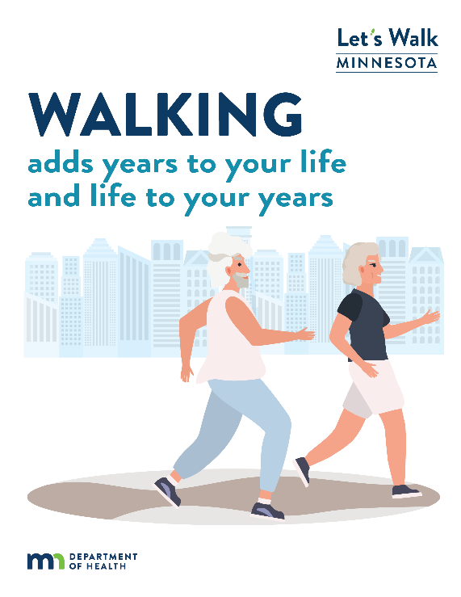
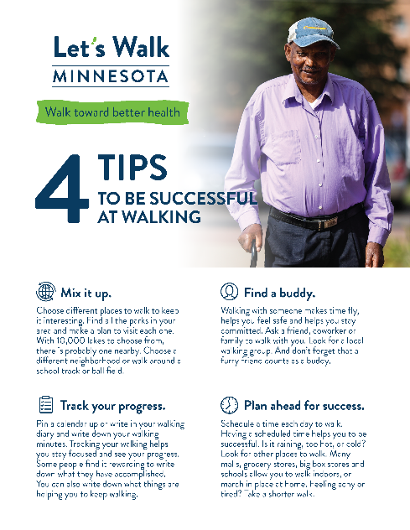
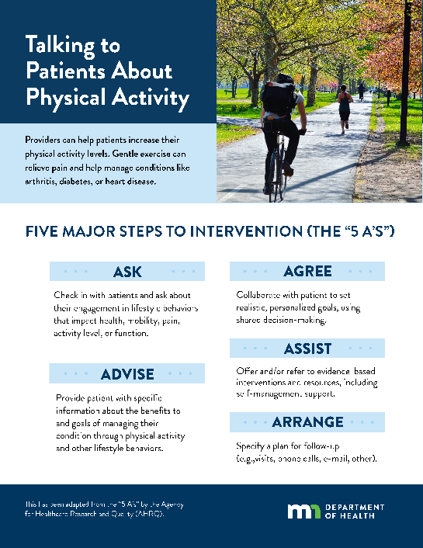
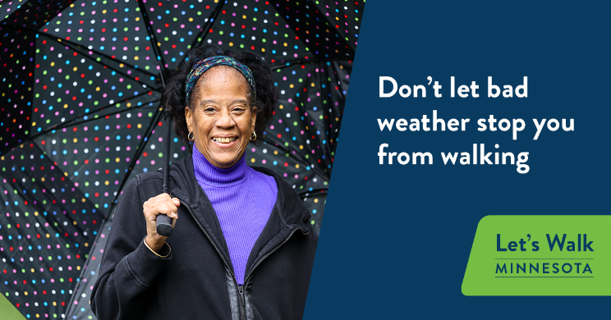
Communication Resources
Let’s Walk Minnesota Toolkit
Messages, flyers, social media posts, posters, graphics, email content, mailers, etc.
Tips for starting a walking program & physical activity counseling

Slide 53
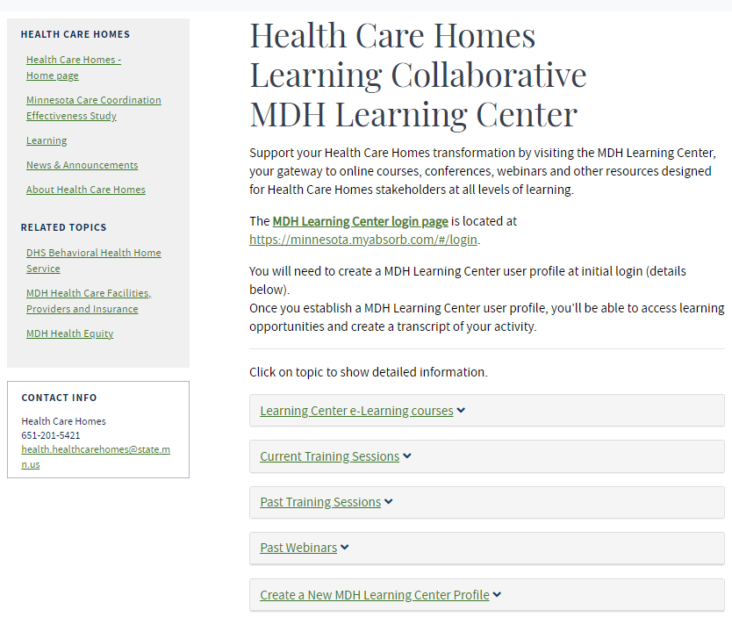
Other resources and trainings
Arthritis Online Training Module for CHWs
MDH Health Care Homes Learning Center
CDC
Osteoarthritis Action Alliance: oaaction.unc.edu
Arthritis Foundation: arthritis.org

Slide 54
Thank you!

Slide 55
Affordable Insulin in MN
Minnesota Insulin Safety Net Program
https://www.mninsulin.org/
URGENT NEED PROGRAM -- Eligible Minnesotans can receive a 30-day supply of insulin immediately at their pharmacy for no more than $35.
CONTINUING NEED PROGRAM -- Eligible Minnesotans can receive up to a year supply of insulin for no more than $50 per 90-day refill.
Notes:
The Minnesota Insulin Safety Net Program was created to help Minnesotans who face difficulty affording their insulin. The program is made up of two parts. The urgent need program and the continuing need program.

Slide 56
Contact Information
Bridget Ideker – Diabetes Planner bridget.Ideker@state.mn.us
Kim Mateen - Diabetes Planner kim.matteen@state.mn.us
Erin McHenry Wolf – Arthritis Program Coordinator Erin.McHenry.Wolf@state.mn.us

Slide 57
Resources
Control Your Diabetes for Life Toolkit https://www.health.state.mn.us/diseases/diabetes/manage/resources.html
Diabetes Risk Test - English https://doihaveprediabetes.org/ Spanish https://doihaveprediabetes.org/es
Population-Level Indicators for Monitoring the Picture of Diabetes in Minnesota https://www.health.state.mn.us/diseases/diabetes/diabetes-dashboard/index.html
Prediabetes in Minnesota Fact Sheet https://www.health.state.mn.us/diseases/diabetes/docs/prediabetesfacts.pdf
Let's Walk Minnesota Toolkit https://www.health.state.mn.us/diseases/arthritis/about/walktoolkit.html
Walk With Ease Self-Directed Portal https://startwalkwithease.org/Identity/Account/Register/minnesota
Physical Activity Programs List https://oaaction.unc.edu/wp-content/uploads/sites/623/2023/06/Physical-Activity-AAEBI-Cross-Sectional-Chart.pdf/

Slide 58
Resources
MDH Diabetes Webpage Managing Diabetes - MN Dept. of Health (state.mn.us)
10 Simple Steps 10 Simple Steps to Enjoying a Life with Diabetes (state.mn.us)
The American Diabetes Association https://diabetes.org
The Association of Diabetes Care and Education Specialists https://www.diabeteseducator.org
Diabetes Food Hub – recipes for people with diabetes Diabetes Food Hub
adces-community-health-workers-as-diabetes-paraprofessionals-in-dsmes-and-prediabetes---final-4-1-20.pdf (diabeteseducator.org)

