Slide 1
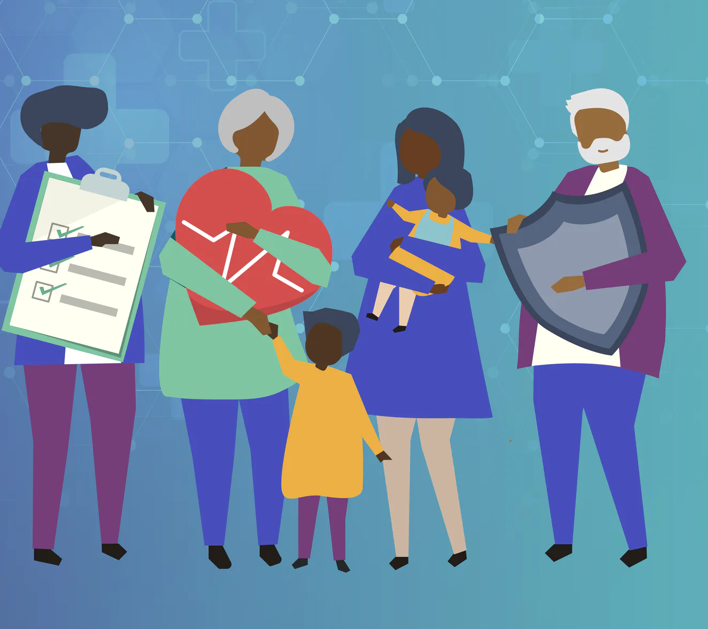
Increasing Cultural Humility in Rural MN: How the Past Informs the Present
Ashley Charwood, LGSW, MSW
Sierra Charwood, CNA, BA/MD Student and the University of MN
a.r.charwood@gmail.com

Slide 2
Tentative, Flexible Agenda
Historical Impacts
Modern Implications
Strategies/Tools -IDI, Cultural Iceberg, Perspective Taking, AAA, Raven
Scenarios/ Lived Experiences
Insights/ Goals/Joys

Slide 3
Practice the Seven Generation Thinking
Those who do not learn history are destined to repeat it. /“Those who cannot remember the past are condemned to repeat it.” -Writer and philosopher George Santayana
Sankofa: The Sankofa bird of the Ghana Tribe in Africa reminds us that
we must move forward as remember the past,
and at the same time, plant seeds for future generations.

Slide 4
Diversity- Understood as a numerical representation of differences among people, viewpoints, experiences.
Inclusion- An environment where commonality and differences are fully utilized to achieve the groups outcomes. All people, viewpoints, and experiences heard and counted.
Culture- the customs, arts, social institutions, and achievements of a particular nation, people, or other social group.
Equity- The quality of being fair and impartial. Addressing the disparity of resources.
Belonging- The psychological feeling connectedness to a social, spatial, cultural, professional, or other type of group or a community
Terminology
https://www.youtube.com/watch?v=K1F8krZqTK0
Cultural Humility VS Competence
Notes:
Cultural Humility

Slide 5
Isolate Race:
Historically and contemporarily
Notes:
Noticing patterns

Slide 6
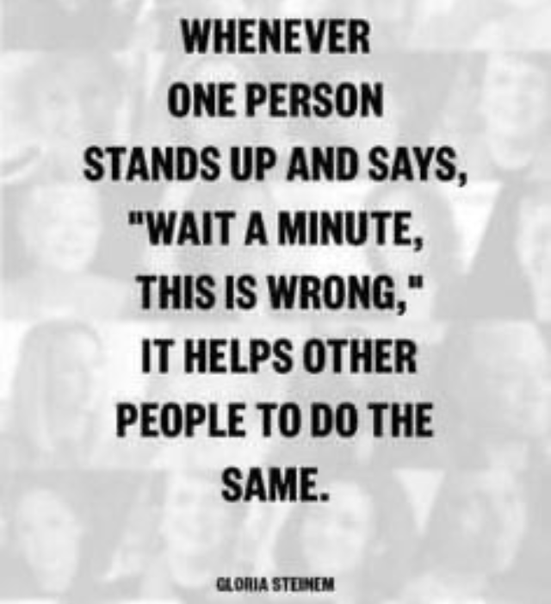

Slide 7
Reflect on the past

Slide 8
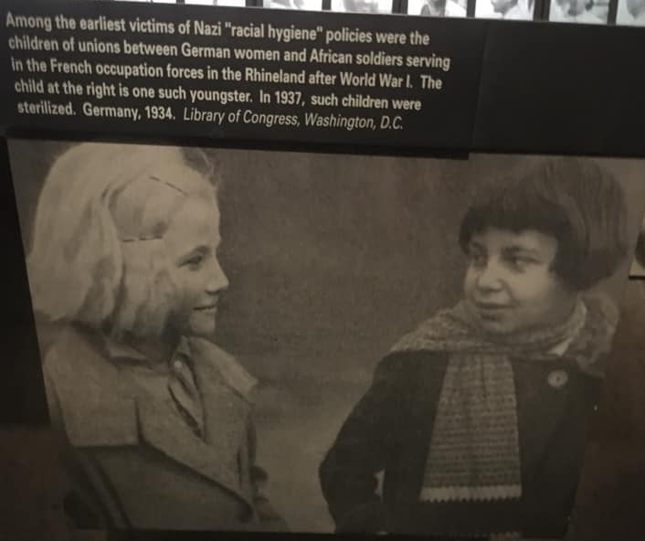

Slide 9
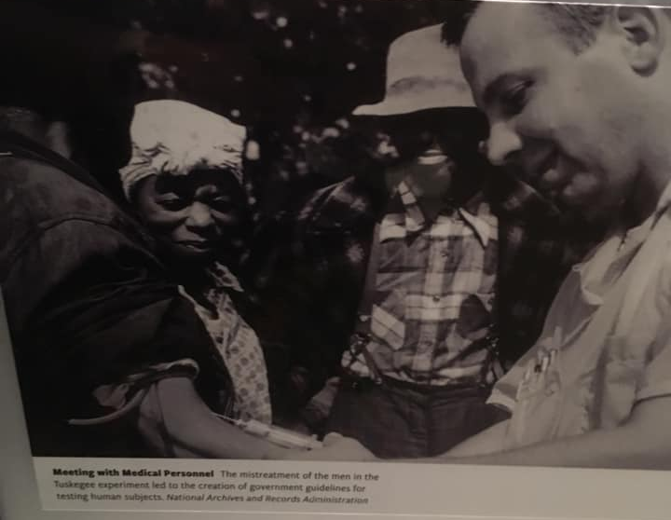
Notes:
The medical establishment has a long history of mistreating Black Americans — from gruesome experiments on enslaved people to the forced sterilizations of Black women and the infamous Tuskegee syphilis study that withheld treatment from hundreds of Black men for decades.

Slide 10
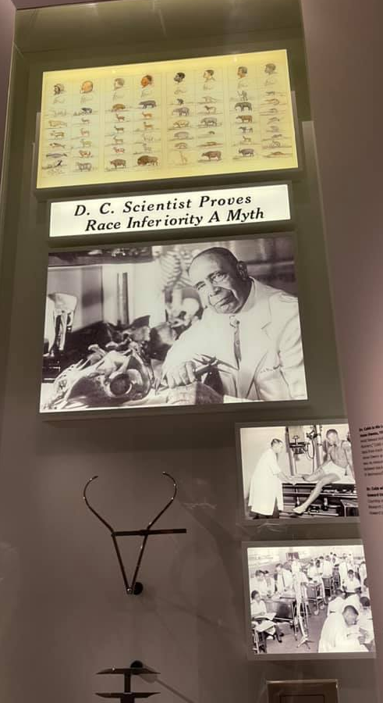
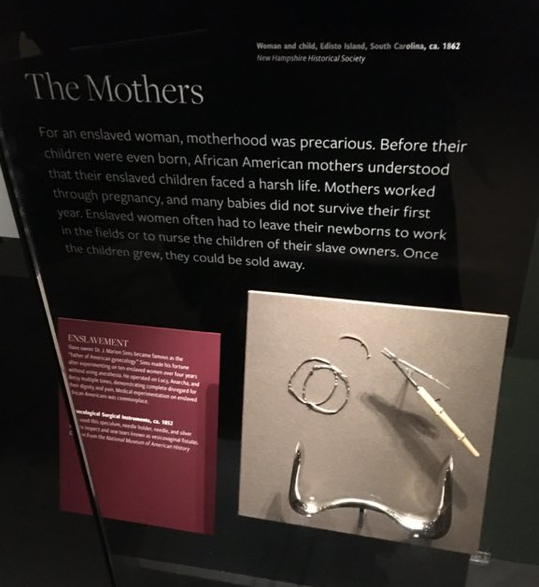

Slide 11
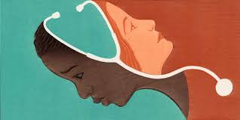
Over the six-year period that had followed the passage of the Family Planning Services and Population Research Act of 1970, physicians sterilized perhaps 25% of Native American women of childbearing age, and there is evidence suggesting that the numbers were even higher. Some of these procedures were performed under pressure or duress, or without the women’s knowledge or understanding.
(Theobald, Brianna. 2019.)

Slide 12
Modern Day Implications:
Studies have found that medical mistrust is not just related to past legacies of mistreatment, but also stems from people’s contemporary experiences of discrimination in health care — from inequities in access to health insurance, health care facilities, and treatments to institutional practices that make it more difficult for Black Americans to obtain adequate health services.
Policing for Black men; Medical for Black Women
George Floyd and Hardell Sherrel
Systems and Reporting (Ambulance, Health Care, Criminal Justice.
Vocal Bystander & Perspective Taking
Social Aggressions, Invalidations, Insults

Slide 13
Data
Among active physicians, 56.2% identified as White, 17.1% identified as Asian, 5.8% identified as Hispanic, and 5.0% identified as Black or African American. (Association of American Medical Colleges, 2022.)
40% of first- and second-year medical students endorsed the belief that “black people’s skin is thicker than white peoples.” (Sabin, Janice, 2020.)
In a survey of 222 white medical students and residents, about half endorsed false beliefs about biological difference between Blacks and Whites…And those who did also perceived Blacks as feeling less pain than whites. (Swetlitz, 2016)
Black women are three to four times more likely to die from pregnancy-related causes than white women, according to the Centers for Disease Control and Prevention. (Center for Disease Control, 2022)
In one study of 218 people, Over 1/3 of the sample reported experiencing a microaggression in interactions with their health providers. (Walls, M; Gonzalez, J; Gladney, T; and Onello E. 2015.)

Slide 14
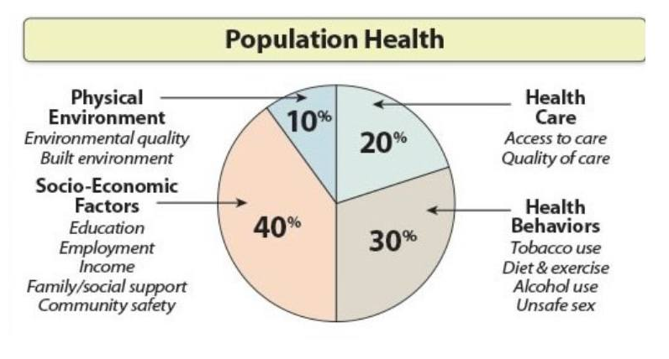
Clinical encounters in which the stakes of not addressing mistrust are high, including childbirth, childhood vaccination, and the care of patients with HIV, cancer, and substance use disorder. (The Commonwealth fund, 2021.)
Studies have found Black Americans experience differential treatment. The health care system often gives short shrift to the physical and emotional tolls of exposure to police brutality; substandard housing and schools; polluted neighborhoods; or other parts of the daily experiences of some Black Americans. (The Commonwealth fund, 2021.)
Social Determinants of Health

Slide 15
Modern Implications, Connections
Environmental Racism- Water and Land, and Food.
Immunizations- In general.
Pain tolerance- H.S. and Gillian's Barre, childbirth, maternal death rates
Skin/Blood conditions- Sickle Cell Anemia, Mongolian spots, bruise patterns, etc.
Adoption- Medical HX, lack of “age” appropriate testing's.
Communication styles- Assertive, passive, direct, indirect, verbal, nonverbal, languages- interpreters AAEV)
Learning Styles- Written, verbal, visual, etc.
Sterilization & Access to contraception
Invasive and experimental medical studies
Haldol and Blacks
Research validity
Medical provider mistrust
Removal of children
Number of Black and Indigenous people in certain nursing homes.
Assumed religion
Stress, microaggressions***
Indigenous Course Requirements
Ethnic Studies HS Graduation Requirements

Slide 16
Strategies/Tools to Bridge to Joy

Slide 17
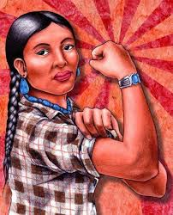
What can be done?
Listen to people of color.
Validate and affirm their lived experiences
Fund Universal health care
Support afterschool sports and funding for transportation
Eliminate outdated, racist policies that are based on white supremacy
Use an equity lens when creating new policies to build a positive organizational culture around hair, hiring, etc.
Prioritize DEIJ
Learn more about your own culture
Be intentional about learning more about other cultures
Involve the Elders
Don’t tokenize
Discuss learning and communication styles
Treat people the way they want to be treated
Flatten the Hierarchy
Use correct name and pronouns Phonetically
Flatten the Hierarchy
Invest wisely- Catering, contracts, etc.
Hold funders accountable
Meet people where they are at.
Be in community.
Reduce and eliminate barriers- consider transportation, confidentiality, etc.
Avoid victim blaming
Interrupt interruptions
Discuss historical and current institutional racism with team.
Improve communication, increase transparency, create welcoming environments.
Create a healthy organizational culture, reflective of the community being served- staff, posters, language, food, board, etc.
Provide voting education.
Pay people for their emotional and mental labor.

Slide 18
Identities that shape us:
Start with Self
Hometown
Racial and Ethnic background
Education background
Marital Status
Parental Status
Sexual Orientation
Socioeconomic status
Gender
Age
Religion
Nationality
Ability
Work Experience
Transportation Access
Passport
Problem Solving Skills
Talents
Language
Housing
Body Size
Which identities can be easier to name?
Which identities have changed over time?
Which aspects are visible? Which aspects cannot be hidden?
Which aspects are invisible? Harder to see?
Which aspects have been historically, systematically oppressed?
Have you noticed times when you’ve been treated differently because of aspects of your identity?
Diversity to Inclusion
Inclusion to Connectedness
Connectednes to Equity
***Further training on the Identities available upon request.

Slide 19
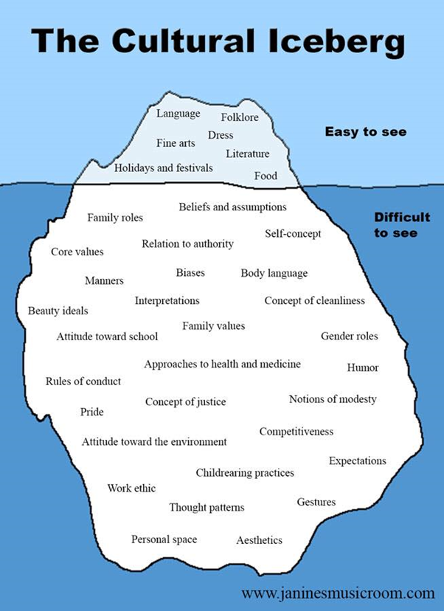
The Cultural Iceberg
Maximum feasible participation
Create Prompts.
Learn about team members.
Learn about where our blinders are.
Reflect on Culture and its impact.
Connect to Mission & Work.
Race as a social construct.

Slide 20
Using the iceberg to have intercultural conversations to inform policies and organizational culture
Cultural Characteristic:
Applications/Policies:
Relation to authority:
Body Language:
Work ethic/Incentives:
Approach to medicine and Health:
Attitudes toward school:
Personal space:
Communication Styles:
Foods:
Youth Serving agency, Adults, Housing, Those with a felony
Close talker, eye contact, video conferencing
Learn to be aware of and challenge our own biases
Work hard, play hard. Natural job duties. Stay at home parent, volunteerism, performance reviews
Agency policies on vaccinations, sick leave policies
Youth serving agency, employment credentialing, employment duties/skills/qualifications.
Office sharing, cubicles, nursing room, break room
Verbal, nonverbal, written, video, paper examples with photos, on boarding.
Potlucks, religious preferences, ceremonious food, vendors for conferences/events.

Slide 21
Using the iceberg to have intercultural conversations to inform policies, approach, and organizational culture
Applications:
Cultural Characteristic:
Speaking at events, how board meetings are ra, talking circle, signage, written documents.
Policies on recycling, paper products, products at events, feminine products in bathrooms, gardening, growing own food.
Yelling, distracting, strict, dominating, first teacher, child care use, love and logic: office policies, child care policies, bias awareness, child serving agencies.
Non verbal's. Faial expressions. One finger.
Ten minutes early, on time, a few minutes later, get there when we get there. Relying on others for transportation, childcare, etc. Policies, programs, grants.
Language:
Attitude towards the environment
Child rearing practices
Gestures
Importance of Time

Slide 22
Using the iceberg to have intercultural conversations to inform policies and organizational culture
Cultural Characteristic
Application:
Beauty
Attitudes towards age.
Relationship with animals
Flags, Music, dances, holidays, literature
Influence of race, skin color, gender, sexual orientation
Talents
Policies on tattoos, gender expression, hair styles, clothing.
Retirement policy, cross cultural, intergenerational trainings, programming for all ages, volunteering for all ages.
Policies on staff brining animal, service users bringing in animals.
Outside signage, flags, community events, holiday PTO policies.
Potlucks, gotcha cards, rewards
Inclusive workplace policies
Succession planning, employee performance reviews.

Slide 23
Self reflection:
Food:
What common foods were ate growing up in your household.
What traditional foods do you enjoy?
Communication:
What is your communication style? (Passive, assertive, aggressive? AAVE)
Written, Verbal, Video.
Time: What are your attitudes towards time?
Learning style:
Reading, watching, doing.
Verbal, written, viewing.
Personal Space:
Close talker, physical touch.
Beauty:
Clothing, hair, head wraps, tattoos, piercings
When might cultural differences show up in the workplace with coworkers/ clients?
When might conflicts around these differences occur in the workplace?

Slide 25
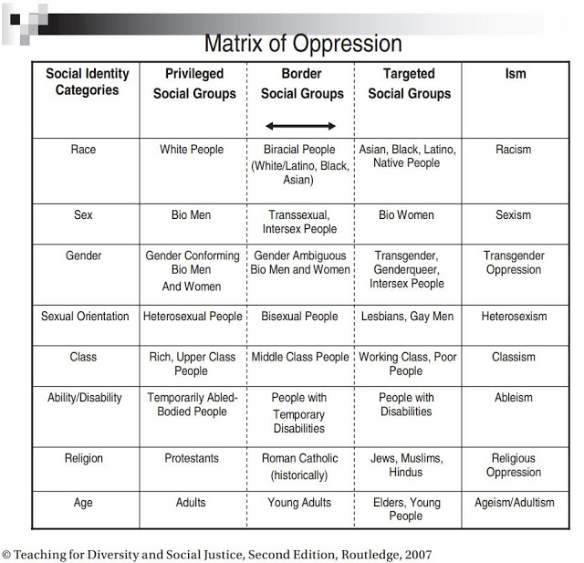
Intersectionality
How to get build a board, organization, or team culture where these identities are valued, affirmed, heard, and not tokenized?
Harvard Implicit Bias Test: https://implicit.harvard.edu/implicit/takeatest.html

Slide 26
Identities and Belonging:
Heard
Validated
Affirmed
Trust
Represented
Safe, Seen, Soothed leads to Secure

Slide 27
Changes over time:
Gendered Language:
Policeman VS Police Officer
Mail man VS Mail Carrier
Freshman vs First year student
Airmen vs fliers/pilots
Spokesman vs spokesperson
Chairmen vs chairperson
Slavery:
Slave Owners vs Human Traffickers
Mistresses' vs Rape victim/survivor
Trading vs Kidnapping and paid for
Discipline vs torture/murder
Profiting vs theft/stole
Race:
Mongoloid, Negro, Ni****, Mullato, Black, African American, African descendant of people who were slaves.
Reds**s, Indian, First Nation, Indigenous, Tribal Name
Others:
Adoption Language:
real parent vs Birth parent
Illegitimate vs Born to unmarried parents
Give up vs Terminate parental rights
Give away vs Make an adoption plan
To keep vs To parent
Reunion vs Making contact with
Track down vs Search
Unwanted child vs Child placed for adoption
Child taken away vs Court termination
Reproductive Health:
Hermaphrodite vs Intersex
Transsexual vs Transgender
Venereal Disease vs Sexually Transmitted Disease vs Sexually Transmitted Infections
Clean and Dirty, vs Used, and Unused.
Person Centered Language:
Slave VS person who was enslaved
Disabled person VS Person with different abilities
Wheelchair Bound VS Person in a wheelchair

Slide 28
Bias and Microaggressions
 | Microaggression - is a term used for brief and commonplace daily verbal, behavioral, or environmental indignities, whether intentional or unintentional, that communicate hostile, derogatory, or negative prejudicial slights and insults toward any group, particularly culturally marginalized groups.
 | Microinvalidation - Verbal comments or behaviors that exclude, negate, or nullify the psychological thoughts, feelings or experiential reality of a person of color.
 | Unconscious biases - are social stereotypes about certain groups of people that individuals form outside their own conscious awareness.
 | Bias - prejudice in favor of or against one thing, person, or group compared with another, usually in a way considered to be unfair.
***Further training on the various types and examples of these.
Notes:
Supervisors can help create inclusive teams. Can hold their team accountable. Can bring out the strengths of their teams.
You speak English surprisingly well.
Your name is hard to pronounce
You’ve done so well despite your background.
You are pretty for an Asian.
You don’t act like a girl.
You don’t dress like a boy.

Slide 29
Racial and Cultural Diversity & Disparities
How much racial and cultural diversity existed in the community you lived in during the years you were growing up?
What are some changes needed in your workplace?
How can you influence or make these changes?
Policy examples
What are the disparities today in your community/organizations that you are a part of affecting/addressing/changing- (arts, housing, employment, education, childcare etc.)

Slide 30
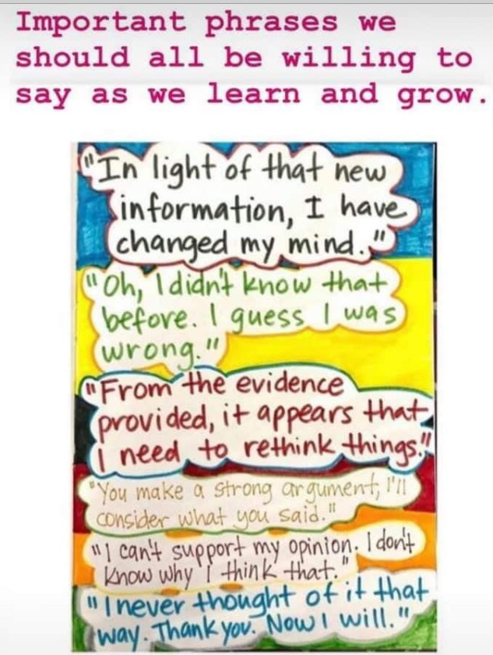
Sometimes we are in the wrong too.
Express sorrow
Own and name the wrong
Name the impact
No ifs/blames/buts
Make amends
Watch your thoughts, for they become your words. Watch your words, for they become your actions, watch your actions, because they become your habits.
–Margaret Thatcher
Notes:
May I offer you a different perspective.

Slide 31
Raven:
J. Luke Wood & Frank Harris III
AAA
R: Redirect the interaction
A: Ask probing questions
V: Values clarification
E: Emphasize your own thoughts and feelings
N: Next steps
A: Acknowledge
A: Ask
A: Adjust

Slide 32
Self-Reflection
Where did you learn to stand up for things that you believe in?
What are you doing to learn about other races, ethnicities, and cultures?
Reflect on a podcast, movie, book, event, etc. that elevated or educated you about a Black or Indigenous communities.

Slide 33
SCENARIO’S: Immunizations, Mongolian Marks, Assumptions
A Black mom attends her medical appointment for their 1-year-old daughter. The nurse wants to give the child an updated immunization. The mother reports that they just went to the Public Health WIC clinic and got the immunization and declines the shot. The nurse becomes irritated and continues to push the immunization.
A mother brings in her bi-racial Native American and Black child in for a routine visit. The nurse notices a mark on the child’s bottom. The mother reports this is a Mongolian spot, typical in Babies of African American descent. The nurse brings it up to the doctor who assures the nurse that it is a Mongolian spot.
A pregnant teen goes in to for a medical appointment and the fetus gets measured. The doctor tells the women that Black women tend to have smaller babies. The mom goes on to have that child at almost 6.5 pounds, and 3 additional children, weighing between 7.14 and 8.4.
A Black women request the medical doctor to colorectal exam of some sort due to intense stomach pains, and not knowing medical history. Doctor denies it. Woman goes to ER and is diagnosed with severe diverticulitis.

Slide 34
SCENARIO 2: Hair
Your coworker, Shanelle, got their hair put in micro braids, and attended work. The supervisor asked Shanelle if they were planning on going out in the community with clients with their hair looking like that and said “It could give the clients a negative experience with landlords or employers to be seen with the someone with their hair like that. We all need to look professional.”
What may have been going on here?
What could you do/say?

Slide 35
SCENARIO 3: Name and Gender
A patient, Santicito, uses They/Them pronouns. They have shared this when they first met you, and it is listed in their file. A colleague continues to misgender them during the appointment, and has introduced them to another colleague, as she. That same team member also continues to say Santicito’s name incorrectly.
What are your thoughts?
What could you do/say?

Slide 36
Policies and Committees
Have you seen similar scenarios play out like this at your organization?
What policies do these scenarios connect to?
What committees/ workgroups can take this info/ lessons learned and make policy change or create organizational impact?

Slide 37
Racial Equity Lens
1.) Think about the history.
2.) Think about the current organization culture.
3.) Think about who the policy marginalizes/serves?
What are some goals. Which organizational values support the creation of a new policy?
How can this policy be redesigned/ revised?
4.) Abundant Thinking:
Next Steps: What/who is needed to make changes to this policy/practice? / What strategy should be started soon? Who is responsible for each step? What are alternatives to explore?
Adapted from the Minnesota Council of Nonprofits

Slide 38
Bridging to Joy: For a hopeful future 1. See more representation in the field. 2. See more access to sports and sciences/stem. Provide more resources to underserved communities. 3. Less Med mistakes 4. People should be listened to and believed. 5. Learn about BIPOC medical experts: first heart transplant, HeLa, Etc. 6. Black Medical books 7. Keep the conversation and learning going.

Slide 39
What gives you hope?
What are your ideas for next steps to continue the journey toward cultural humility?
What tools from today will you incorporate into your practice/ personal life?
Look closely at the present you are constructing it should look like the future you are dreaming.
- Alice Walker

Slide 40
Commitments: https://www.wintersgroup.com/make-the-commitment-to-live-inclusively/
I commit to be intentional about spending time getting to know myself, so that I am better positioned to understand others.
I will acknowledge my own biases and challenge them.
I will acknowledge that I do not know what I do know, and I will not use that is unconscious as an excuse.
I will be intentional about exposing myself to difference. If I do not know, I will acknowledge, ask, and adjust.
I will accept responsibility in increasing my own knowledge and understanding.
I will commit to speaking up and speaking out even when I am not directly impacted, as there is no such thing as neutrality in the quest for justice, equity, and inclusion.
I will try to accept and adapt, rather than tolerate. I commit to pausing and listening. I will be empathetic to the experiences and perspective of others. I will use my privilege positively and get comfortable with my own discomfort.
I commit to knowing, getting, and doing better than I did yesterday, keeping in mind that my commitment to live inclusively is a journey not a destination.

Slide 41
References:
Association of American Medical Colleges, 2022. Diversity in Medicine: Facts and Figures 2019 Retrieved from: https://www.aamc.org/data-reports/workforce/interactive-data/figure-18-percentage-all-active-physicians-race/ethnicity-2018
Center for Disease Control, 2022. Working Together to Reduce Black Maternal Mortality Retrieved from: https://www.cdc.gov/healthequity/features/maternal-mortality/index.html
Cultural Humility, 2015.Retrieved from: https://www.youtube.com/watch?v=K1F8krZqTK0
Harvard Implicit Bias Test, 2011. Retrieved from: https://implicit.harvard.edu/implicit/takeatest.html
Intercultural Development Inventory, 2021. Retrieved from: https://idiinventory.com/
Sabin, Janice, 2020. How we fail black patients in pain Retrieved from:
https://www.aamc.org/news-insights/how-we-fail-black-patients-pain
Swetlitz, Ike. 2016. Some medical students still think black patients feel less pain than whites
Retrieved from: https://www.statnews.com/2016/04/04/medical-students-beliefs-race-pain/
The Commonwealth fund. 2021. Transforming Care: Understanding and Ameliorating Medical Mistrust Among Black Americans. Retrieved from: https://www.commonwealthfund.org/publications/newsletter-article/2021/jan/medical-mistrust-among-black-americans
Theobald, Brianna. 2019. Mass Sterilization of Native American Women. Retrieved from: https://time.com/5737080/native-american-sterilization-history/
Walls, M; Gonzalez, J; Gladney, T; and Onello E. 2015. Unconscious Biases: Racial Microaggressions in American Indian Health Care. Retrieved from: https://www.ncbi.nlm.nih.gov/pmc/articles/PMC4386281/
Wood, J. Luke; & Harris III, Frank. 2022. RAVEN. Retrieved from: https://www.ohsu.edu/sites/default/files/2020-06/RAVEN%20approach%20to%20microaggressions.pdf

Slide 42
Thank you! Miigwech
Ashley Charwood, LGSW, MSW, DSW Student at Tulane University
a.r.charwood@gmail.com
Sierra Charwood, CNA, BA/MD Student and the University of MN

